Slide 1
About this presentation
The visiting team chair presentation template has been designed to either be presented in its entirety or broken out. The visiting team chair will determine how many pre-visit meetings will take place and what content will be covered in each meeting. A suggested breakdown follows:
Slides 1 – 74 during an introductory team web meeting;
Slides 74-81 during a second team web meeting;
A recap of slides 35-73 plus slides 82-87 and during the final meeting of the visiting team, at the first meeting of the team during the visit itself.
Some content has been re-purposed from the Summer/Fall virtual visit training webinars.
The intent of this presentation is to deliver consistent training of program visitors by visiting team chairs.
Programs receiving visits may be interested in reviewing this presentation for their own information or for sharing with their faculty and staff who are involved in the visit.
This presentation is updated annually to reflect ongoing improvements to the accreditation criteria, policies, and procedures.

Slide 2
Accreditation Visit to <name of HEI> <date range>
Name of Presenter
Title

Slide 3
Land acknowledgement
I would like to begin by acknowledging the Indigenous Peoples of all the lands that we are on today. While we meet today on a virtual platform, I would like to take a moment to acknowledge the importance of the land, which we each call home. We do this to reaffirm our commitment and responsibility in improving relationships between nations and to improving our own understanding of local Indigenous peoples and their cultures.
From coast to coast to coast, we acknowledge the ancestral and unceded territory of all the Inuit, Métis, and First Nations people that call this nation home.
Please join me in a moment of reflection to acknowledge the harms and mistakes of the past and to consider how we are and can each, in our own way, try to move forward in a spirit of reconciliation and collaboration.

Slide 4
Outline
HEI Background
Accreditation and the CEAB
Roles and responsibilities
Leading up to the visit
The criteria
Recent relevant changes
The visit
The report

Slide 5
Higher Education Institution (HEI) Background
History and current situation
<when HEI opened>
<current student complement>
<any major contextual factors>
Purpose of this visit
<list programs being visited>
<indicate when these programs were most recently visited and what the CEAB decisions was>
Notes:
More information related to this slide
Information shown on this slide is a summary. Full information about the institution and the program being visited is developed by the institution and supplied to team members 8 weeks in advance of the visit, in the “Questionnaire”.

Slide 6
2022/2023 Visit Cycle
The visit cycle will be in-person
Unless local health unit directives require a transition to virtual
The following ‘on-site’ visit materials will now be made available in an electronic format 4-6 weeks before the visit start date:
A. Course Materials (including A1 and A2)
B. Graduate Attribute and Continual Improvement onsite documentation
D. Safety Manuals and Procedures
Notes:
At their February 5-6 meeting, the CEAB discussed the format of the 2022/2023 visits given the current pandemic situation. It was decided that the CEAB is currently planning for all visits during the 2022/2023 visit cycle to be conducted in-person; however, visits may be required to transition to a virtual modality due to health directives.
All programs hosting visits in the 2022/2023 visit cycle are to make the following ‘onsite materials’ (per the 2022/2023 Questionnaire) available to the visiting team electronically four to six weeks prior to the visit date, the final date to be decided on by the visit chair in consultation with the HEI:
A. Course Materials (including A1 and A2)
B. Graduate Attribute and Continual Improvement onsite documentation
D. Safety Manuals and Procedures
Should current local health directives preclude you from hosting your accreditation visit in person, or should they change in the lead-up to your visit, please inform your visiting team chair and accreditation coordinator as soon as possible so that contingency plans can be made.

Slide 7
Accreditation and the CEAB

Slide 8
The Accreditation Board
Established in
1965
Accredits undergraduate engineering educational programs
Volunteer members are
20 P.Eng./ing.
Deans, former deans, senior faculty members, and industry representatives
Most members from academia have also worked in industry
30% of members are women, 45% of members are bilingual

Slide 9
Goals of the Accreditation Board
Ensure that engineering programs in Canadian institutions meet minimum educational standards for professional licensure.
Ensure continuous improvement of engineering education.
Provide advice on international engineering education and accreditation.
Notes:
The CEAB is composed of 20 members, drawn from both academia and industry, with representation from across the country, and includes both French and English speakers, and men and women.

Slide 10
What does the Accreditation Board do?
Paper review
Visit
Report
CEAB
accreditation decision
The visiting team
Program information gathering and review
Visiting team not responsible for accreditation decisions
Notes:
Some have compared the process to an “audit”:
Teams of experts review program information, both on paper and on-site.
They gather information about the programs in a visit report.
The team tri-angulates evidence from the Questionnaire, on-site interviews, on-site documentation review.
This report, plus any additional relevant information, as well as the Board’s collective experience is used to produce accreditation decisions.

Slide 11
CEAB Accreditation: General notes
Accreditation:
Applies only to programs (not to departments or faculties)
Is undertaken only at the invitation of the HEI and with the consent of the appropriate regulator
Constitutes:
Quantitative and qualitative evaluation of the curriculum
Qualitative evaluation of the program environment
Is granted for a period up to, but not exceeding, six years

Slide 12
How do we do it? The accreditation process:
1
Request for accreditation
HEI submits RFA
HEI completes Questionnaire
1
2
Build the visit team
Visit Chair assigned and team selected
HEI approves visiting team
Preparatory teleconferences
Visit date selected
8
2
8
CEAB decision
Visit dossier prepared for CEAB meeting
Accreditation decision
Communication of decision
3
Questionnaire
HEI completes and submits Questionnaire 8 weeks prior to visit
Build visit schedule
7
18 MONTHS
3
7
Visit report
CEAB editor reviews report for consistency
Report sent to HEI dean
HEI dean check for accuracy and completeness
4
Program materials
HEI makes program/course materials available during site visit
6
4
6
5
Write report
Visitors prepare tracking of issues
Chair compiles visiting team report
5
Reporting
Interviews and observations
Data collection
2.5-day site visit
Holds interviews according to schedule
Notes:
At all stages: ongoing communication between the Dean/Designated Official and the Team Chair.

Slide 13
Accreditation and continual improvement
Program
outcomes evaluated
Changes planned (curriculum, courses, performance metrics, etc.)
Changes implemented
Data
collection
and
evaluation
Accreditation is based on a snapshot in time of a given program
The accreditation process has a definitive start and end
HEIs must continue to continually improve for the duration of their accreditation period
Plan. Do. Check. Act

Slide 14
Accreditation activities
299
Accredited programs
44
HEIs in Canada
0
0

Slide 15
Resolution of issues
June decision meetings
 | 2020 | 2021 | 2022
# of programs | 52 | 10 | 71
# of issues identified | 325 | 27 | 187
Issues resolved* | 60 (18%) | 12 (44%) | 53 (28%)
Issues unresolved | 265 (82%) | 15 (55%) | 134 (72%)
* as a result of deans’ response
Notes:
The accreditation visit is a fact-finding process. The number of issues identified are done so through the review of the questionnaire materials and through what is observed during the site visit.
Context for 2020 numbers:
GA/CI criteria were applied to many programs for the first time. Therefore, it’s the first time the HEI is presenting their GA/CI information and the first time that they are assessed. Meanwhile, the CEAB is well into the evaluation of the GA/CI criteria so they are practiced. Many of the resolved issues were related to GAs which may indicate that the HEI did not present all of the information with their Questionnaire that would demonstrate compliance, the visiting team missed or misinterpreted the information as presented, or the program made changes between the visit and the report. More likely a balance of the first two explanations than the second.
Context for 2021 numbers:
As per the Engineers Canada Board’s May 2020 decision, the 2020/2021 accreditation visit cycle was deferred for one year, and all programs were granted a one-time, one-year extension to their accreditation term in response to the COVID-19 pandemic. This included a 1-year extension on report deadlines. Some programs submitted their reports as per their original schedule which accounts for these numbers.

Slide 16
Roles and responsibilities

Slide 17
Objectives of the visiting team
Conduct fact-finding on behalf of the Accreditation Board
Review, validate and/or add to the information provided by the HEI
Examine submitted materials (the questionnaire and on-site), meet with program officials, the facilities
Corroborate program strengths and weaknesses
Triangulate evidence
Collaborate to prepare a report of the visiting team’s findings
To bring forward issues to the CEAB
The visiting team does not make any recommendations.
Accreditation decisions are made by the CEAB.
Notes:
This list of objectives of the visiting Team is provided in more detail in the “Accreditation Criteria and Procedures 2018”, including the list of accreditation criteria grouped in the following categories:
Continuous Improvement
Graduate Attributes
Students
Curriculum Content
Program Environment
The template for the final report, the deliverable from the Visit, is “Visiting Team Report Template”. Each Program Visitor will complete their own report (or a consensus report when a program has more than one Visitor). Observations by General Visitor, Vice-Chair and Chair will be integrated into the Program Visitors’ reports as well as forming the prefatory and concluding material of the report. In addition, the General Visitor will prepare a report to the engineering regulators/organisme(s) de réglementation having jurisdiction, documenting the process of the visit, using “General Visitor Report to the provincial and territorial engineering regulators ” as a template.

Slide 18
The visiting team: Key roles
Team Chair
Program Visitor(s)
Vice Chair(s)
Observer(s)
General Visitor(s)
CEAB Secretariat

Slide 19
Team and Vice- Chair Key Roles
CEAB member (or past member)
Has overall responsibility for the visit
Prepares and submits the Report of the Visiting Team to the CEAB
Team Chair
Assists the team chair
Evaluates program common core
Evaluates criteria related to graduate attributes and continual improvement
Vice-Chair(s)

Slide 20
General and Program Visitors Key Roles
One or two per visit
Appointed by the provincial regulator
Evaluates occupational health and safety aspects of the curriculum (safety, student projects, support departments and facilities)
Reports findings to the regulator
General Visitor(s)
One per program (two for new programs)
Assesses course content, materials, facilities and program stability
Interviews departmental faculty, staff, and students
Program Visitor(s)

Slide 21
Observers and CEAB Secretariat Key Roles
Observes the aspects of the visit which are of the most interest
Washington Accord, Engineers Canada Board, other accrediting agencies in Canada/international, etc.
Observer(s)
Coordinates the visit from start to end (logistics, support Team Chair, visiting team report, etc.)
Attends visits as requested
Identifies potential process improvements
CEAB Secretariat

Slide 22
Time commitments
ACTIVITY | DUE DATE | TIME COMMITMENT
Review of institution questionnaire Preparation of Tracking of program issues: Working document form Team meetings (called by the chair) Training (including the online training module and 1-3 teleconferences with the visiting team) | 8-4 weeks before visit | 3-5 days
On-site visit | (Saturday evening arrival to Tuesday afternoon departure) | 1 travel day + 3 working days
Completion of visiting team report | Submit to team chair within 2 weeks after visit | 1 day
Notes:
Emphasize the importance of following the pre-visit schedule set by the team chair. While visitors used to have time to review materials on-site, they will be required to do that in advance and in an iterative fashion leading up to the visit. The pre-visit team meetings will help with the review of the materials, so it is important to attend. We saw chairs call more pre-visit meetings during the 2020/2021 accreditation cycle than in the past. They felt this was necessary to adequately prepare the team for the virtual visit. There will be more pre-work for a virtual visit, but it will make the visit itself easier as you will be well-prepared in advance.
As all visits will be virtual, you do not have to plan for travel time.
The visit will still start on Sunday with the GA/CI presentation from the program, but the pre-visit Saturday meeting is likely to be cancelled given the pre-visit team meetings that will have been scheduled.
*The goal is not to extend the visit by any additional interview time. However, because of time zones, it may be possible that an extra calendar day is added to the schedule.

Slide 23
Leading up to the visit

Slide 24
Accreditation criteria and procedures
All visiting team members should:
Become familiar with the criteria
Note the evolution of criteria and interpretive statements
They may have changed since you were last a program visitor!

Slide 25
Training
Online training to be completed by each member of the team
Login details provided by the CEAB Secretariat
Overview of the accreditation process, roles and responsibilities, tips and tricks, etc.

Slide 26
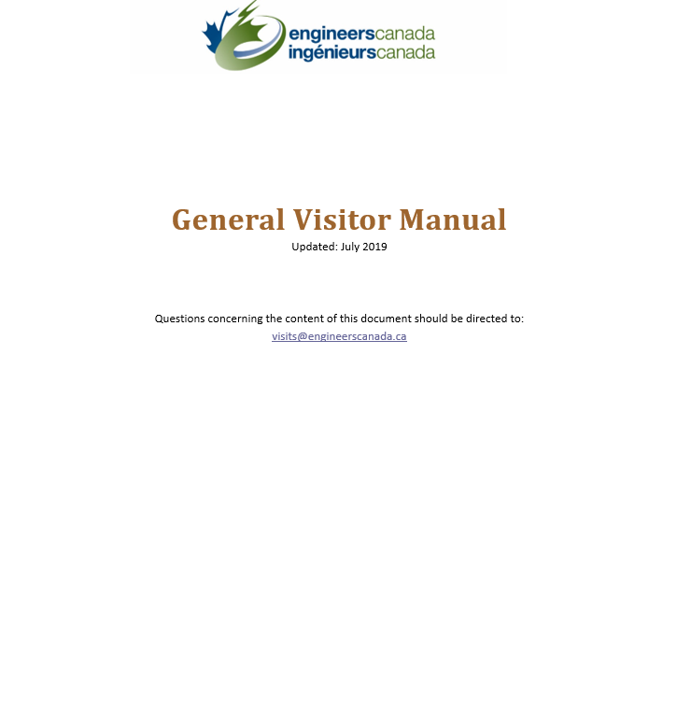
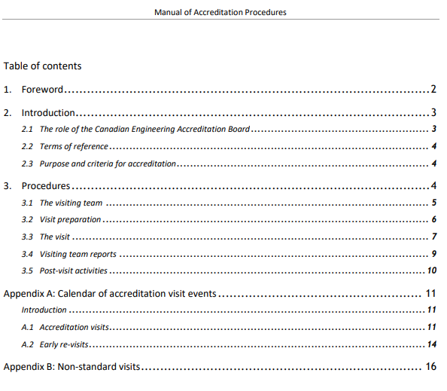
Team resources
www.engineerscanada.ca/accreditation

Slide 27
Team member activities
Comply with Engineers Canada’s Board Code of Conduct.
Attend 2-3 web meetings organized by the Team Chair
The number and frequency of meetings as needed
Getting to know the team
General overview of process
Identification of issues
Planning visit schedule
Individually review program’s questionnaire
Identify issues for investigation during the visit
Complete the Tracking of program issues: Working document

Slide 28
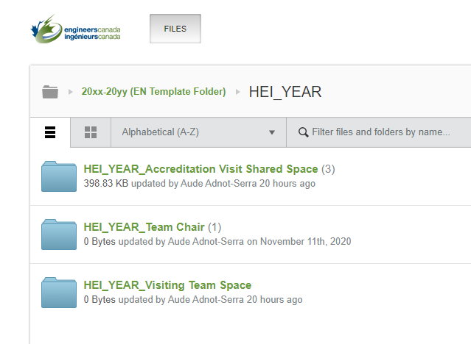
Accessing program materials
Program materials available on the CEAB OneHub site 8 weeks prior to the visit.
The CEAB Secretariat will send an invitation to each team member to access the various applicable files and create their own password if necessary.
Read the materials provided by your assigned program(s).

Slide 29
Accessing program materials, continued
“Sunday” materials to be made available ahead of visit (four to six weeks before the visit start date):
Course materials (A1 and A2)
Graduate Attributes and Continual Improvement samples
Graduate Attributes and Continual Improvement presentation (pre-recorded is preferred)
Safety manuals and procedures
Lab and facilities tours
Notes:
For the materials traditionally made available to the visit team on-site on the Sunday preceding an in-person visit (A1 and A2), the HEI must ensure visit team members have access to course materials and graduate attributes/continual improvement documentation, as described in the on-site materials section of the Questionnaire. These materials can be uploaded with the Questionnaire materials described above, or the HEI is welcome to post these materials on its own learning management system (LMS). If programs are going to make materials available via their LMS or other internal platform, the HEI will be responsible for ensuring all visit team members have access to the platform if personalized accounts (originating from the institution) are required. These materials should be available four to six weeks in advance of the visit, depending on what the designated official and visit chair agree on.

Slide 30
Tracking of issues
Use this tool to record your findings based on your pre-visit review of the institution’s questionnaire.
The visiting team can use this document to develop the site visit schedule and guide discussions while on-site.
When in doubt, consult with the Chair or Vice Chair.
Notes:
Team Chair will liaise with the Dean/Designated official to identify any issues before the team arrives on-site. This reduces the stress for the HEI and makes the visit more efficient. Sometimes more information will be provided by the program to the visitor, other times these discussions inform the development of the visit schedule. Openess and transparency with the HEI is key.

Slide 31
Identifying issues
The “minimum standard” is established by the criterion
and (if one exists) further explained in the interpretive statement.
Your options (NEW!):
✓ = no observed issue on the criterion. Comments could include how the institution complies with the criterion (for example, innovative methods used to ensure compliance, and/or procedures and policies that deserve special mention).
* = item flagged for CEAB review that, in the opinion of the visitor, has the potential to either jeopardize future compliance or currently prevents compliance with the criterion. Justification is required for * observations.

Slide 32
Writing an observation
For each written observation, follow a three-element format:
cite the applicable language from the criterion, policy, or procedure (with quotation marks) as context for the observation;
describe evidence observed; then
describe the positive or negative impacts to the program.
Written observations for * are required.
Written observations for ✓are welcome.
Notes:
It is required that all visiting team members comply with this format.

Slide 33
Tips
Quantitative criteria are binary observations. Either the criteria have been met or not.
Avoid the terms “concern”, “weakness”, “deficiency” in your written comments
These terms are reserved for CEAB accreditation decisions
The CEAB will discuss your findings at a decision meeting where a decision will be made as to whether the program’s compliance to criteria is acceptable, a concern, a weakness, or a deficiency.

Slide 34
The criteria

Slide 35
Accreditation criteria and procedures
The processes of accreditation place emphasis on the quality of the:
Students
Curriculum
Academic staff/support staff
Facilities and resources
Reminder: The onus is on the HEI to demonstrate compliance with the criteria.

Slide 36
About criteria and interpretive statements
Criteria
Describe the measures used by the Accreditation Board to evaluate Canadian engineering programs for the purpose of accreditation.
Interpretive Statements
Additional guidance on the interpretation and application of specific criteria.

Slide 37
Input and outcomes criteria: Why both?
Input criteria
Outcomes criteria
Prescribed exposure times to essential curriculum elements
Defines graduate attributes
ACCREDITATION DECISION
Enables easy calculation of the minimum path
Regular assessment of graduate attribute attainment drives continuous improvement
Notes:
Why BOTH input and outcomes criteria? For HEIs, they thought that we are going to be evolving from input measurement to outcomes assessment. But regulators like inputs. Retaining both, we think we can cut down on work from institutions. Washington Accord countries were all moving toward it so we needed to move with the trend to remain a member. WA membership is important for mobility of engineering. Regulators want this too (if someone applies for licensure from a WA country, there’s comfort there).
Demonstrate that we are doing both inputs and outcomes assessment which requires a whole lot less input data.
Our bosses are the regulators and they are very comfortable with input assessment. Outcomes has not replaced input. Where we are going, we are looking at process as opposed to results… to save HEIs time from proving to the AB that they are right.

Slide 38
Common issues identified
Program environment
Inadequate lab facilities and insufficient space (3.5.1.2)
Inadequate number of full-time faculty (3.5.2.1)
Long-term leaves and long sabbaticals
Soft-funded faculty
Teaching loads ~ critical dependence on a single individual
Curriculum content and quality
Insufficient introduction to a culture of occupational health and safety (3.4.2)
AU adjustments to:
natural sciences (3.4.3.2)
engineering science (3.4.4.2)
engineering design (3.4.4.5)
Notes:
This is not an exhaustive list.

Slide 39
Criteria highlights: Curriculum content and quality
Measured by “Accreditation Units” (AU)
one hour of lecture (corresponding to 50 minutes of activity) = 1 AU
one hour of laboratory or scheduled tutorial = 0.5 AU
Three ways to measure curriculum:
Traditional classroom and lab instruction measured by AUs (3.4.1.1)
Non-contact hours, i.e. K-factor (3.4.1.3)
Innovative engineering teaching methodologies with compelling rationale (3.4.1.4)
Notes:
Accreditation criteria are described in “Accreditation Criteria and Procedures 20xx”.
Assure the minimum path

Slide 40
Minimum curriculum components
Curriculum component | Minimum AUs | AUs To be taught by licensed faculty
Mathematics | 195 | -
Natural sciences | 195 | -
Mathematics and natural sciences combined | 420 | -
Engineering science | 225 | -
Engineering design | 225 | 225
Engineering science and engineering design combined | 900 | *600
Complementary studies | 225 | -
The program must have a minimum of 1,850 AUs
*For engineering science: Licensed faculty members or those within five years of their initial appointment, demonstrating progress towards processional engineering licensure
Notes:
A reduction from 1,950 AUs was implemented in the 2020 criteria book.
VERY IMPORTANT:
While criterion 3.4.6 states that the program must have a minimum of 1850 accreditation units, the AB does not require the program to EXCEED this minimum. The AB does not require or encourage programs to “cushion” their AU counts. If the program has 1850 AUs, the program has met criterion 3.4.6.
The statement on COVID deferral said the HEIs could select which set of criteria they would use (the existing or the new), as such, there may be a difference between the number of required AUs in the criteria book and what the programs reports.

Slide 41
Criteria highlights: Minimum curriculum components
AU allocation is not an exact science
When reviewing course information and materials, consider whether AU allocations are reasonable?
All AU re-allocations are discussed with the visiting team
An ongoing discussion on Sunday and Monday evening
You may discuss AU allocations with the responsible faculty member(s), but no need to argue
Agree to disagree

Slide 42
Criteria highlights: Professional licensure
Dean, Department Chairs, and faculty members teaching courses that are primarily engineering science or engineering design are expected to be licensed to practice engineering in Canada
Criterion 3.4.4.4 minimum of 225AU of ED to be instructed by P.Eng./ing.
Criterion 3.4.4.1 minimum of 600 AU of ES+ED to be instructed by P.Eng., ing., EIT, ing jr., other
Curriculum development and control should be in the hands of persons licensed to practice engineering in Canada
Notes:
Regarding the last point on the slide, note that some individuals in some Provinces will have a license to practice (limited) but not a full-blown P.Eng.

Slide 43
Criteria highlights: Qualitative Evaluation – Curriculum Considerations
Curriculum must include the application of computers and appropriate laboratory experience and safety procedures
Students must be exposed to material dealing with professionalism, ethics, equity, public and worker safety and health considerations, concepts of sustainable development, environmental stewardship
The curriculum must prepare students to learn independently and to work as an effective member of a team

Slide 44
Criteria highlights: Qualitative Evaluation – Curriculum Considerations
Curriculum must include studies in:
communication skills
engineering economics
impact of technology on society
subject matter that deals with central issues, methodologies and thought processes of humanities and social sciences, and;

Slide 45
Criteria highlights: Qualitative Evaluation – Curriculum Considerations
Engineering Design:
integration of curriculum elements
creative, iterative and open-ended
subject to constraints imposed by legislation or standards
to satisfy specification using optimization
economics should be part of the design experience
to be supervised by licensed engineers
Every program must culminate in a significant design experience

Slide 46
Criteria highlights: Graduate attributes
Two components
Attributes (criterion 3.1):
Interpreted at time of graduation
Recognized that achievement does not end there
Program visitors evaluate the evidence and actions used to demonstrate the level of achievement of each graduate attribute
Continual Improvement (criterion 3.2):
Ongoing evolution of engineering programs
Processes needed:
Assessment of attribute achievement
Results used to improve program
Program visitors evaluate the evidence and actions used to demonstrate the continual improvement achievement

Slide 47
Criterion 3.1 - “The institution must demonstrate that the graduates of a program possess the [12] attributes.”
Criteria 3.1.1 - 3.1.5 - Used to assess the suitability of a program for developing the graduate attributes.
3.1.1 Organization and engagement
3.1.2 Curriculum maps
3.1.3 Indicators
3.1.4 Assessment tools
3.1.5 Assessment results
Criteria 3.2.1 – 3.2.3 - Used to assess the institution’s continual improvement processes.
3.2.1 Improvement process
3.2.2 Stakeholder engagement
3.2.3 Improvement actions
Notes:
GA/CI criteria

Slide 48
Criteria highlights: Graduate Attributes
A knowledge base for engineering
Problem analysis
Investigation
Design
Use of engineering tools
Individual and team work
Communication skills
Professionalism
Impact of engineering on society and the environment
Ethics and equity
Economics and project management
Life-long learning

Slide 49
Graduate Attributes: Evaluation by the visiting team
Program Visitors can expect to see:
Graduate Attributes (Accreditation Criteria)
Learning outcomes that support Graduate Attributes
Indicators
Acceptable level of student (graduate) performance
Feedback mechanism
A reminder that programs:
Are assessed, not the students
Are not required to assess every student, in every course, in every year
Use the Graduate Attributes/Continual Improvement rubrics in your evaluation

Slide 50
Organization and engagement: Rubric
✓ | Strong organizational structures and processes are in place that demonstrate the sustainable collection and assessment of GA data. AND clear evidence of engagement by most full-time faculty members and engineering leadership.
* | Weak or limited organizational structures and processes are in place. AND/OR no organizational structures and processes are in place. AND/OR limited or absent engagement of full-time faculty members and/or engineering leadership.
3.1.1
There must be demonstration that an organizational structure is in place to assure the sustainable development and measurement of graduate attributes.
There must be demonstrated engagement in the process by faculty members and engineering
leadership.

Slide 51
Curriculum maps: Rubric
✓ | At least three learning activities for most graduate attributes are mapped. AND distributed across multiple semesters.
* | Less than three learning activities are mapped for many or most graduate attributes. AND/OR many graduate attributes are mapped over a limited number of semesters. AND/OR there are limited processes in place to evaluate the effectiveness of the mapping procedures
3.1.2
There must be documented curriculum maps showing the relationship between learning activities for each of the attributes
and the semesters in which these take place.
Notes:
Information in the curriculum map is:
Accurate, with some depth
Identifies intended outcomes from learning experiences
Not simply a list of topics “covered”
Map provides information for each attribute
Can include curricular and other experiences

Slide 52
Indicators: Rubric
✓ | Measurable indicators describe and span the compliance requirements for each graduate attribute. AND are consistent with expected compliance learning levels for each graduate attribute. AND the number of indicators is consistent with a sustainable data collection program for each graduate attribute.
* | Measurable indicators do not adequately describe or span the compliance requirements of several or most graduate attributes. AND/OR are not consistent with expected compliance learning levels for several or most graduate attributes. AND/OR the number of indicators is not consistent with a sustainable data collection program for many or most graduate attributes.
3.1.3
For each attribute, there must be a set of measurable, documented indicators that describe what students must achieve in order to be considered competent in the
corresponding attribute.
Notes:
"GA component" – a component of the attribute description in section 3 of the “Accreditation Criteria and Procedures” (e.g. mathematics is a component of the knowledge base description)
"Performance Levels" – a scale of descriptors of the performance corresponding to an individual indicator. Performance levels for a coherent group of indicators corresponding to individuals are aggregated to measure graduate attribute achievement levels.
An indicator is like a sensor: what indicators has the program chosen?
Where have they placed their indicators? Where are the data collection points?
Does the data collection plan make sense? (i.e. Are Indicators well chosen? Are assessment points well chosen? Is valid, reliable data collection proposed? Is plan cyclic, continuous?)
Indicators align with attributes and questions
Indicators are “leading indicators”: central to attribute; indicate competency
Enough indicators defined to identify strength areas and weak areas within an attribute
Not too many indicators – resulting in reams of data but little deep information
Indicators are clearly articulated and measurable

Slide 53
Assessment tools: Rubric
✓ | The nature and number of selected assessment tools for the learning levels for each graduate attribute is reasonable. AND the rationale for their selection is well documented.
* | The nature and number of selected assessment tools for the learning levels for several or most attributes is not reasonable. AND/OR the rationale for the selection of the assessment tools is not well documented. AND/OR the rationale for the selection of the assessment tools is not documented.
3.1.4
There must be documented assessment tools that are appropriate to the attribute and used as the basis for obtaining data on student learning with respect to all twelve attributes over a cycle of six years or less.
Notes:
On what does the program propose collecting data (i.e. indicators)? What methods are proposed for collecting data?
Learning is generally demonstrated through:
Artifacts, e.g. written test, report, built project
Performances, e.g. oral presentation, observed practice
Indicators are well aligned to the proposed assessment points
Enough assessment points are utilized
Expectations of performance quality are clear, i.e. the scale is defined
Definitions:
Valid Indicators measure what they are supposed to measure
Reliable Indicators the results are consistent; the measurements are the same when repeated with the same subjects under the same conditions
Direct measures directly observable or measurable assessments of student learning
Indirect measures opinion or self-reports of student learning or educational experiences
Use both direct and indirect measures if possible.

Slide 54
Assessment tools: Examples
Examinations
Final
Mid-term
Entry and exit
Standardized (PPE, FE)
Oral
Embedded questions
Portfolios
Culminating design experience
Projects
Laboratories
Internship/stage
Co-op
Surveys
Exit
Alumni
Employers
Self
Course Evaluations
Advisory Board
Student Work
Reports
Peer Reviews
Reviews/critiques
Presentations
Posters

Slide 55
Assessment results: Rubric
✓ | Assessment results are compiled and documented for all graduate attributes over a period of six years or less. AND At least three learning activities for most graduate attributes are assessed. AND results demonstrate that the graduate cohort has achieved the HEI compliance requirements for most graduate attributes OR that remedial action is in progress.
* | Assessment results are compiled and documented for most graduate attributes over a period of six years or less. AND/OR assessment results have not been compiled or documented for most attributes over a period of six years or less. AND/OR Less than three learning activities for some graduate attributes are assessed. AND/OR many graduate attributes are assessed over a limited number of semesters. AND/OR results demonstrate that the graduate cohort has not achieved the HEI compliance requirements for most graduate attributes OR no remedial actions are being taken. AND/OR the processes are in place but not consistently applied by all participants in the process.
3.1.5
At least one set of assessment results must be obtained for all twelve attributes over a period of six years or less. The results should provide clear evidence that the graduates of a program possess the attributes or that
remedial action is in progress.

Slide 56
Continual improvement: The big picture
At a high-level, programs are expected to continually evaluate and improve where necessary;
There must be processes in place that demonstrates that program outcomes are being assessed in the context of the graduate attributes
Are students meeting expectations?
In what areas are students successful?
What areas of the program require improvement?

Slide 57
Continual improvement The feedback loop
If observed outcomes are not consistent with expected attributes, then system inputs and/or process must be adjusted.
Program
outcomes evaluated
Changes planned (curriculum, courses, performance metrics, etc.)
Changes implemented
Data
collection
and
evaluation
Plan. Do. Check. Act

Slide 58
Improvement process: Rubric
✓ | Adequate continual improvement processes are in place that demonstrate program outcomes are being assessed and applied to the further development of the engineering program AND clear evidence of engagement by most full-time faculty members and engineering leadership.
* | Absent or limited continual improvement processes are in place that demonstrates program outcomes are being assessed and applied to the further development of the engineering program AND/OR process is not adequately documented AND/OR limited or absent engagement of full-time faculty members and/or engineering leadership.
3.2.1
There must be processes in place that demonstrate that program outcomes are being assessed in the context of graduate attributes and applied to further development of the program.
Notes:
Triangulation in improvements process:
Are opportunities included for informal assessment, students’ self-reports of learning, and even unsolicited data from placement supervisors or employers?
Are more than one type of assessment used when analyzing data?
Are all assessments valued, not just major events?
Are the data gained from assessment used to answer questions about authentic learning?
Are data across time intervals looked at?

Slide 59
Stakeholder engagement: Rubric
✓ | Internal and external stakeholders are broadly selected (e.g. internal: students, program faculty, engineering and/or nonengineering faculty; external: alumni, engineering professionals, other professionals, employers, learned societies, etc.) AND stakeholder roles in the improvement process are adequately demonstrated.
* | Internal and external stakeholders are narrowly or insufficiently selected. AND/OR stakeholder roles in the improvement process are inadequately demonstrated or are not specified
3.2.2
There must be a demonstrated engagement of stakeholders both internal and external to the program in the continual improvement process.

Slide 60
Improvement actions: Rubric
3.2.3
There must be a demonstration that the continual improvement process has led to consideration of specific actions corresponding to identifiable improvement sin the program and/or its assessment process. Note, if the evidence suggests no change is warranted, then no change is necessary. This criterion does not apply to new programs.
✓ | Following decisions for improvement, evidence-based program-level and/or assessment process improvement actions have been implemented (if change was necessary) AND timelines and accountability for implementation have been documented.
* | Despite decisions for change, only a limited number of or no evidence-based program-level and/or assessment process change actions have been implemented (if change was necessary). AND/OR no timelines or accountability for implementation have been established.

Slide 61
GA/CI myth busting
Myth | Truth
Employer surveys cannot be used to assess Graduate Attributes. | Programs can use employer surveys to assess Graduate Attributes. Employer surveys are an acceptable assessment tool.
CEAB accreditation criteria does not allow non-engineers to take engineers courses. | The criteria do not define which students are permitted to take which courses. If non-engineering student data is included in GA/CI evaluation processes, the data may be skewed.

Slide 62
Recent relevant changes -
To criteria, procedures, tools

Slide 63
Interpretive statement changes
2020 Interpretive statement on licensure expectations and requirements | 2021 Interpretive statement on licensure expectations and requirements
Clause 8 In order to ensure that engineering science, engineering design, natural science, mathematics and complementary studies curriculum contents are readily and easily identifiable, each course in an engineering program should be described using a maximum of three curriculum categories (ES, ED, NS, Math, CS) with no single category constituting less than 8 AU’s or 25% of the total AU for a particular course. Clause 9 It is up to the institution offering the program to justify the unique aspects of any course that deviates from clause 8. | Clause 8 Engineering science, engineering design, natural science, mathematics, and complementary studies curriculum content should be readily and easily identifiable through learning outcomes, learning activities and assessments attributable to each category in each course where they appear. Clause 9 Removed.
Notes:
Pemberton
Working with the EDC, the P&P and CEAB sought to modernize the Interpretive statement on licensure expectations and requirements by removing caps on the minimum requirements for AUs in a course that can be counted. This respects current pedagogical practices that see content threaded throughout programs and courses for maximum impact for students.

Slide 64
Toward a greater focus on GA/CI process
On February 10, 2018 the CEAB agreed that outcomes assessments should place a greater focus on GA/CI processes.
Having both input and outcomes assessment criteria
=
greater focus on GA/CI processes and less focus on assessment results.
Programs still need to demonstrate:
achievement of graduate attributes
continuous improvement
The use of both input and outcomes assessments is desired by many regulators.
HEIs are in the best position to determine graduate attribute compliance and
to implement required program improvements
Notes:
The graduate attributes remain a key part of the accreditation criteria.
Programs are still asked to provide their latest assessment results for each graduate attribute but are not asked to provide all assessment data for every learning activity.

Slide 65
2021 / 2022 Documentation Focus on GA/CI process: Summary of changes
Exhibit 1
Select 3 – 5 courses (or learning activities) used to assess achievement of each GA. For each course, discuss curriculum maps, indicators, and assessment tools.
Discuss assessment results for each Graduate Attribute.
Questionnaire
Reduces the on-site “Graduate Attributes Dossier” by focusing on three examples where change to a program was considered rather than ALL data for ALL changes.
On-site GA/CI presentation: Describe overall GA/CI process; reflection on what’s working and what’s not working on the GA/CI process.
Notes:
Exhibit 1:
Documentation submitted in advance of the visit focuses on GA/CI process and not on data.
Reduces the documentation required (before, we asked for data related to EACH COURSE. Now we are asking for samples).
We are focusing more on process and less on data. The data demonstrates the execution of a process.
Questionnaire:
Changes to “GA dossier”
Current instructions are vague; results in a LOT of data/documentation on-site
New GA/CI onsite documentation instructions are more clear, more focused on what the visiting team really needs to evaluate the PROCESS
Rubrics:
GA / CI rubrics guides the visiting team on how to assess the GA / CI criteria.
Helps the team describe their findings to the CEAB.

Slide 66
Optional COVID-19 Addendum to the Questionnaire
Which courses, if any, were delivered online, in class or in combination, and how were Accreditation Units (AUs) calculated?
For courses that were held in-class, what measures were taken to ensure the safety of students and faculty?
How were classes with either a lab component or field exercises handled?
Were there any significant changes to the delivery of capstone design projects? If so, please describe.
How were your plans for the final year of the program changed due to measures taken in response to the pandemic? What were you planning to do vs. what was implemented?
What, if any, attrition do you expect?
How have course and lab instructions been changed to address pandemic concerns, and what impact have these changes had on GA/CI processes?
Notes:
To better understand the impact that the COVID-19 pandemic has on undergraduate engineering education programs in Canada, HEIs have been given the opportunity to respond to the following questions. These questions will give the visiting team and the CEAB a greater appreciation for how programs across Canada have responded to the COVID-19 pandemic.
The purpose is not to assess how well programs adjusted to the pandemic. We’re looking to know what happened last year and what the programs’ plans are for the future. The addendum is intended to collect contextual information to help the visit team understand a program’s situation when you review their materials/engage in the interviews.
HEIs have been told to be sure their answers are succinct, and not exceed five pages. HEIs were also told that if they choose to complete the addendum, it should be submitted with the Questionnaire submission. Further, an accreditation visit is not dependent on completing this addendum, but HEIs were encouraged to do so if they felt the additional information will help visiting team members understand the context of the program during the snapshot year being used.

Slide 67
The visit A fact-finding exercise

Slide 68
Overview
2.5 - 3 days
Sunday, Monday, Tuesday
October-November - existing programs
January-February - new programs
3 Objectives:
Validate and seek clarification of program(s) details based on a review of the institution’s completed Questionnaire.
Gather information about the program(s) and assess evidence of compliance with criteria
Evaluate the measures taken to resolve issues raised previously by the Accreditation Board regarding the program(s) (if applicable).
Example of visit schedule – Engineers Canada website
Notes:
The visits generally start on Sunday with the GA/CI presentation from the program, but the pre-visit Saturday meeting is likely to be cancelled given the pre-visit team meetings that will have been scheduled.
Some meetings are optional, based on the visiting team and HEI’s needs. On their first pre-visit teleconference, the visiting team chair is encouraged to discuss with team members which of the optional meetings should be included in the visit schedule. The primary objective of the visit is to validate and seek clarification of program details based on the team’s review of the institution’s Questionnaire. The team members should reflect on information they need from any individual to perform their assessment of the institution’s compliance with the CEAB criteria and the schedule should be built to achieve this objective.

Slide 69
Interviews: Tasks and tools
“Trust then verify”
Interviews with:
senior administrative officers (i.e. president, dean of engineering, the program chairs, etc.)
faculty
Students
Support staff
Areas to explore evidence of:
compliance with graduate attribute criteria
professional attitudes
motivations
morale
the balance of opinions concerning theoretical and practical elements of the curriculum
Notes:
In carrying out the tasks listed on this slide, “Suggested Interview Questions for CEAB Visits” is a helpful resource, along with the description of accreditation criteria given in “Accreditation Criteria and Procedures”.
Program visitors are not expected to ask each question, verbatim. Instead, visiting team members should consider the questions they might wish to ask of the program while reviewing the questionnaire materials. The Guide is not meant to be a checklist, it is meant to be a tool to help program visitors triangulate the visit data.
The questions that will be asked during the site visit relate to areas where the team needs more information in order to document their findings, areas requiring additional information. If questions are not asked about a specific area or initiative, it does not signal a lack of interest on the CEAB’s part.

Slide 70
Tours: Tasks and tools
Evaluate the effectiveness of facilities such as:
laboratories
libraries
computing facilities
The Accreditation Board does not require Faculty to spend money
Visitors investigate whether the equipment, supplies, etc. are adequate
Program materials to determine whether performance expectations and grading standards are appropriate. For example:
examination papers
laboratory instruction sheets
student transcripts
student reports and theses, models or equipment constructed by students
other evidence of student performance
Notes:
For tasks related to review of program material, program visitors refer to their own experience of course materials. In addition, the Engineers Canada Syllabus is a resource.
General visitor, in assessing physical facilities, can refer to “Manual of General Visitor”.
Chair and Vice-Chair, in examining transcripts, can refer to “Accreditation Criteria and Procedures”, including the “Regulations for granting transfer credits”.

Slide 71
Visit Schedule
Schedule is built based on the needs of the visiting team and HEI using the CEAB sample
Specific meetings suggested for each visiting team member (Chair, Vice-Chair, Program Visitor, General Visitor)
Day 1 (Saturday) optional‏
Schedule overview
Example of visit schedule – Engineers Canada website

Slide 72
Visit Schedule cont’d.
Day 2 (Sunday)‏
Team pre-visit meeting
Meet with program officials
Graduate attribute/continual improvement presentation*
Review course materials
Team meeting to discuss:
previous decision issues and areas to be re-examined
observations and findings
potential issues that warrant further investigation
Day 3 (Monday)‏
Dean, Administrators, faculty, support services, etc.
Team evening meeting to build consensus around:
areas of strength
issues that require further investigation
Notes:
Team members will together review the combined list of potential issues that they have separately developed using the “Tracking Program Issues: Working document” form.
Team members each revise their preliminary draft of their contribution to the “CEAB Visiting Team Report”.
*This presentation is dependent on the preference of the program. They may submit it electronically in advance, or deliver it live.

Slide 73
Visit Schedule cont’d.
Day 4 (Tuesday)‏
Update with Dean
Wrap-up interviews and tours
In camera Team Working Lunch:
Complete draft reports
Arrive at consensus on final conclusions
Draft copies of each program report submitted to the chair
Exit meeting (possibly held the following day, depending on scheduling)
Attended by dean, program chairs, faculty, students
Verbal exit statement delivered by the Team Chair
Summary of all issues that will be included in the report
Notes:
During the exit meeting, it is re-iterated that accreditation decisions are made only by the Accreditation Board. Repeat time-line of the process to follow. Emphasize confidentiality. Summarize all issues and state strengths. Thank the Dean and staff for visit arrangements and their hospitality

Slide 74
Site visit
“Do’s” and “Don’ts”
DO
DON’T
Participate in all visiting team meetings
Check everything you question with the responsible individual(s)
Keep a list of who attended the interviews
Maintain confidentiality at all times
Ask open ended questions
Assume the answer to anything you question
Give suggestions to the program – stick to the facts (suggestions for improvement could be included in the visiting team report)
Surprise the program with statements in your report that were not communicated during the exit meeting

Slide 75
The Visiting Team Report

Slide 76
The visiting team report: “Do’s” and “Don’ts”
DO
DON’T
Complete your report (before the exit meeting at the latest).
Include all issues tied to criteria in your report.
Be available to answer questions about your report after the visit.
Dig for the full picture and describe it accurately in your report.
Use the terms “concern”, “weakness” or “deficiency” in your written comments.
Make recommendations for improvement in the body of the report. Instead use the section titled “suggestion for improvement…”
Use student names.
Re-format the template provided.
Notes:
Accurate Visit Team reports are an essential part of Canada’s overall system for improving accredited engineering education. When issues are identified during site visits and reported, institutions are motivated to carry out necessary improvements. The cycle of improvement includes opportunity for the institution to address issues and avoid losing accreditation. If you are unsure whether to draw attention to an apparent issue, seek support from your Visit Team Chair.
Do not hesitate to dig for the full picture and describe it accurately in your report

Slide 77
Identifying issues
The “minimum standard” is established by the criterion
and (if one exists) further explained in the interpretive statement.
Your options (NEW!):
✓ = no observed issue on the criterion. Comments could include how the institution complies with the criterion (for example, innovative methods used to ensure compliance, and/or procedures and policies that deserve special mention).
* = item flagged for CEAB review that, in the opinion of the visitor, has the potential to either jeopardize future compliance or currently prevents compliance with the criterion. Justification is required for * observations.

Slide 78
Writing an observation
For each written observation, follow a three-element format:
cite the applicable language from the criterion, policy, or procedure (with quotation marks) as context for the observation;
describe evidence observed; then
describe the positive or negative impacts to the program.
Written observations for * are required.
Written observations for ✓are welcome.
Notes:
It is required that all visiting team members comply with this format.

Slide 79
Tips
Quantitative criteria are binary observations. Either the criteria have been met or not.
Avoid the terms “concern”, “weakness”, “deficiency” in your written comments
These terms are reserved for CEAB accreditation decisions
The CEAB will discuss your findings at a decision meeting where a decision will be made as to whether the program’s compliance to criteria is acceptable, a concern, a weakness, or a deficiency.

Slide 80
After the visit
+2 weeks
Program visitors finalize their draft report
Chair compiles visiting team report
+4 weeks
CEAB editor reviews report for consistency
Report sent to HEI dean
HEI dean checks for accuracy and completeness
June
Visit dossier prepared for CEAB meeting
Accreditation decision
Communication of decision

Slide 81
Thank you!
For more information:
accreditation@engineerscanada.ca | 613.232.2474
engineerscanada.ca/accreditation

Slide 82
Virtual Visit Back-Up Slides
For use should a visit be transitioned to the virtual modality

Slide 83
Time commitments
ACTIVITY | DUE DATE | TIME COMMITMENT
Review of institution questionnaire Preparation of Tracking of program issues: Working document form Team meetings (called by the chair) Training (including the online training module and 1-3 teleconferences with the visiting team) | 8-4 weeks before visit | 3-5 days
Virtual visit | Sunday – Tuesday/Wednesday | 3 working days*
Completion of visiting team report | Submit to team chair within 2 weeks after visit | 1 day
Notes:
Emphasize the importance of following the pre-visit schedule set by the team chair. While visitors used to have time to review materials on-site, they will be required to do that in advance and in an iterative fashion leading up to the visit. The pre-visit team meetings will help with the review of the materials, so it is important to attend. We saw chairs call more pre-visit meetings during the 2020/2021 accreditation cycle than in the past. They felt this was necessary to adequately prepare the team for the virtual visit. There will be more pre-work for a virtual visit, but it will make the visit itself easier as you will be well-prepared in advance.
As all visits will be virtual, you do not have to plan for travel time.
The visit will still start on Sunday with the GA/CI presentation from the program, but the pre-visit Saturday meeting is likely to be cancelled given the pre-visit team meetings that will have been scheduled.
*The goal is not to extend the visit by any additional interview time. However, because of time zones, it may be possible that an extra calendar day is added to the schedule.

Slide 84
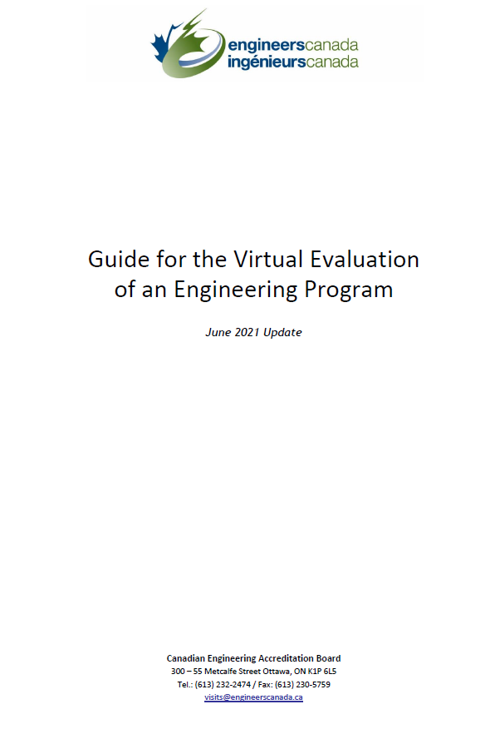
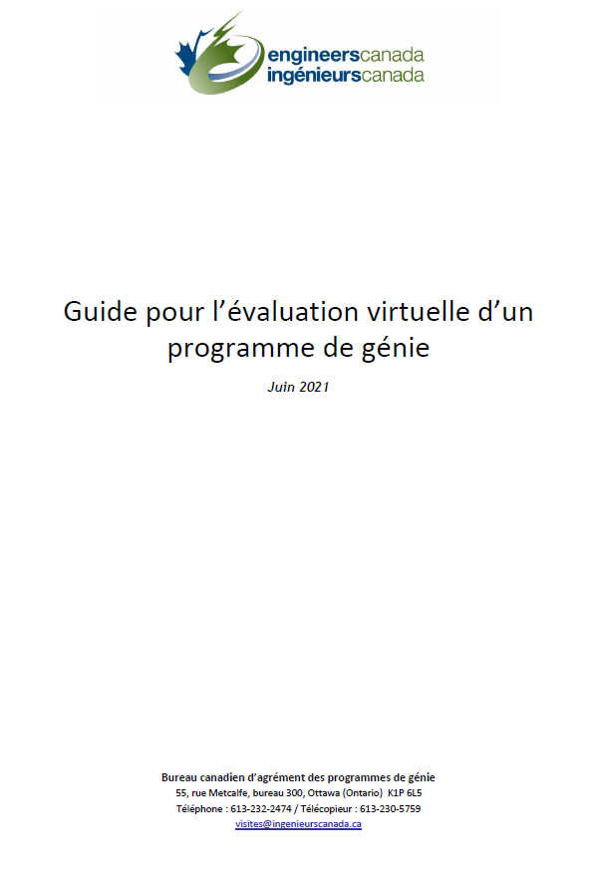
Considerations for the virtual visits
Notes:
Travel restrictions and physical distancing requirements due to the COVID‐19 pandemic requires the 2020/2021 CEAB accreditation visit cycle to adjust. Where the visit would normally take place in‐person, the CEAB has struck a taskforce to develop an approach to virtual accreditation visits. The Guide for the virtual evaluation of an engineering program serves as a starting point to help programs prepare for their review and provides the visiting team the data it requires to complete their evaluation.
The guide has been shared with the institution being visited. The Visiting Team Chair and the Designated Official have been in regular contact to fine-tune the logistical details of the visit.
All visiting team members should read this document.
The CEAB will be flexible on the “snapshot year” of data that the programs submit to the visiting team. Programs that have collected data during 2019/2020 academic year for the 2020/21 visit cycle will be permitted to submit this data to the visiting team during the 2021/2022 visit cycle. (April 2020 CEAB statement on COVID)

Slide 85
Some additional considerations for the virtual visit
Confidentiality policy applies regardless of visit format
Recording and screen captures of meetings is not permitted
Visit team members are responsible for the erasure of all visit materials from their computer systems after the June CEAB meeting

Slide 86
Some additional considerations for the virtual visit
Technology considerations
Engineers Canada’s meeting platform will be used for all team meetings
The institution’s meeting platform will be used for meetings with program representatives
Ensure you have:
a secure, wired internet connection
a webcam
a quality headset and mic
We ask that you use the Engineers Canada virtual background for all meetings during the visit. Your accreditation coordinator will send you the necessary files.
All participants in virtual interviews are asked to be flexible and understanding of fellow participants who may be taking the meeting from their home; noise from family and pets may be unavoidable, though participants should make efforts to limit these instances.
Guide pgs: 4-6
Notes:
Meetings
Meetings involving representatives of the HEI will be hosted on the HEI’s videoconferencing platform (unless other arrangements are required, as per the section in the Guide on video conferencing).
Any meetings of just the visiting team will be hosted on Engineers Canada’s platform.
All participants in virtual interviews are asked to be flexible and understanding of fellow participants who may be taking the meeting from their home; noise from family and pets may be unavoidable, though participants should make efforts to limit these instances.
Equipment
We ask that you ensure you have a stable internet connection for the period of the virtual visit. Wired connections are recommended, but a stable Wi-Fi connection is also acceptable.
High-speed networks (LTE or 4G+) should only be used if regular internet connections fail.
You will be on camera for large portions of the visit, so be sure you have a camera that is either built-in to your computer or can be plugged in.
Audio will be important! If you will be participating in meetings in a noisy environment, make sure you have a reliable and high-quality headset and microphone.
Branding
We ask that you use the Engineers Canada virtual background for all meetings during the visit. Your accreditation coordinator will send you the necessary files.

Slide 87
Some additional considerations for the virtual visit
In addition to the Questionnaire, more material will be made available (electronically) to the visiting team ahead of the visit, including:
Virtual tours of laboratory spaces, study spaces, club spaces, teaching facilities;
Course material typically distributed to students in each course (course outlines, homework assignments, lab instruction sheets, project instructions, quizzes, exam questions, etc.)
‘A1’ material typically be distributed to students for every learning activity in the program.
‘A2’ 15-20 learning activities used to assess achievement of the Graduate Attributes
Samples of graded student work, tests, problem sets, examinations, laboratory and design reports, etc.)
Graduate attribute / continual improvement documentation
Safety manuals and procedures
Visitors should not ask for anything that they would not normally ask to see on-site.
Visitors should be prepared for delays if they request access to a document that the program keeps in a paper format; digitizing may require extra time.
Guide pgs: 7-11
Notes:
If, in your assessment of the documents, you have questions/would like to see additional materials, speak with your visit chair who will make the request to the program.
Please remember that the pandemic may have had an impact on the programs’ delivery and ability to collect data and, as such, anomalous data may be evident in the materials submitted. The CEAB has previously indicated to the HEIs that it will be flexible with regards to the ‘snapshot year’ being used. Please be aware of this possibility, and be sensitive/flexible when addressing this issue in your review of the materials.

Slide 88
Logistics
Expenses
Training
Notes:
In order to facilitate your participation as a visit team member, we invite you to order lunch and/or dinner and expense the cost to Engineers Canada for the days where you are meeting with you team/program officials and stakeholders. As per our expense policy, the suggested subtotal for lunch is $21 and $52 for dinner. This suggested amount is exclusive of any taxes, tip, delivery or service fees incurred to have your meal delivered safely. In addition, any out-of-pocket expenses you may incur may be reimbursed as per our policies. If you have any questions, please contact your Accreditation Coordinator.
Link to policy/claim form: https://engineerscanada.ca/about/governance/policies-documents-and-resources/expense-claim-policy
Additional training will be offered to all stakeholders in the accreditation system in the coming months. Please visit the accreditation resources page for the 2021/2022 cycle for a schedule of events and pre-recorded webinars.

Slide 89
Virtual Visit Training
Description | How to view
An introduction to virtual accreditation visits This session is a ‘virtual visits 101’ primer for visiting team members that will walk participants through the processes laid out in the Guide for the Virtual Evaluation of an Engineering Program. | Available on the Engineers Canada, Accreditation Resources page for 2021/2022: https://engineerscanada.ca/accreditation/accreditation-resources/2021-2022-accreditation-cycle/ceab-webinars-virtual-visits-training

Slide 90
Virtual visit lab tour
Two stages:
Pre-recorded video
Live walk through (as required)
Focus on:
Labs relevant to the program
being assessed
Study spaces
Club spaces
Teaching facilities
Our thanks to ABET for sharing this resource with the CEAB.
Notes:
For the first stage, the program is requested to provide a recorded virtual tour of the facilities in advance of the visit date. The video tours should be submitted along with the Questionnaire, but no later than four weeks before the visit; final due dates should be discussed with the visit chair.
The second stage will be a live walk-through of the space(s) identified to the Dean or designated official by the visit team chair. No more than one hour of the visit schedule should be dedicated to this exercise. The purpose of this second stage is to allow visitors to focus on specific aspects of the program’s delivery site(s) and ask questions about the facilities that may have arisen from their review of the pre-recorded tour discussed in stage one.
This video, prepared by ABET as a sample for their programs undergoing review, will provide you with a sense of what the virtual walk through may look like. [Start video, pop ahead a few minutes and let it run for 30-45 seconds]

