Slide 1
About this presentation
The visiting team chair presentation template has been designed to either be presented in its entirety or broken out. The visiting team chair will determine how many pre-visit meetings will take place and what content will be covered in each meeting. A suggested breakdown follows:
  Slides 2-78 during an introductory team web meeting;
  Slides 79-85 during a second team web meeting;
  A recap of slides 37-78 plus slides 86-96 and during the final meeting of the visiting team, at the first meeting of the team during the visit itself.
The intent of this presentation is to deliver consistent training of program visitors by visiting team chairs.
Programs receiving visits may be interested in reviewing this presentation for their own information or for sharing with their faculty and staff who are involved in the visit.
This presentation is updated annually to reflect ongoing improvements to the accreditation criteria, policies, and procedures.

Slide 2
Accreditation Visit to
<name of HEI>
<date range>
Name of Presenter
Title

Slide 3
Land acknowledgement
I would like to begin by acknowledging the Indigenous Peoples of all the lands that we are on today. While we meet today on a virtual platform, I would like to take a moment to acknowledge the importance of the land, which we each call home. We do this to reaffirm our commitment and responsibility in improving relationships between nations and to improving our own understanding of local Indigenous peoples and their cultures.
From coast to coast to coast, we acknowledge the ancestral and unceded territory of all the Inuit, Métis, and First Nations people that call this nation home.
Please join me in a moment of reflection to acknowledge the harms and mistakes of the past and to consider how we are and can each, in our own way, try to move forward in a spirit of reconciliation and collaboration.

Slide 4
Outline
HEI Background
Accreditation and the CEAB
Roles and responsibilities
Leading up to the visit
The criteria
Recent relevant changes
The visit
The report

Slide 5
Higher Education Institution (HEI) Background
History and current situation
    <when HEI opened>
    <current student complement>
    <any major contextual factors>
Purpose of this visit
    <list programs being visited>
    <indicate when these programs were most recently visited and what the CEAB decisions was>
Notes:
More information related to this slide
Information shown on this slide is a summary. Full information about the institution and the program being visited is developed by the institution and supplied to team members 8 weeks in advance of the visit, in the “Questionnaire”.

Slide 6
2026-2027 Visit Cycle
The following visit materials will be made available in an electronic format 8 weeks before the visit start date, via Tandem:
      Program operational information (information provided in the Questionnaire and associated documents before the visit)
      GA/CI Detailed Explanation (information may be given at a presentation to all visiting team members or at other meetings during the visit)
      ​Detailed syllabi
      Documentation of assigned work and assessment
      Evaluated student work
      Evidence of a culture of safety (normally observed on-site)
Notes:
All programs hosting visits are to make the following materials available to the visiting team eight weeks prior to the visit date, the final date to be decided on by the visit chair in consultation with the HEI:
Program operational information
GA/CI detailed explanation
Detailed syllabi
Documentation of assigned work and assessment
Evaluated student work
Evidence of a culture of safety

Slide 7
2026-2027 Visit Cycle
Planning for logistics
  Travels should be booked ASAP. Visitors are in charge of booking their travels. That expense may be claimed before the visit starts.
  CEAB Secretariat will book the team’s hotel rooms.
  The expense and reimbursement policy covers:
  By Air: the lowest economy fare that allows for one checked baggage.
  By Rail: Business class with Via Rail.
Notes:
Logistics:
- Book your flight ASAP (lowest economy that allows 1 checked back). They can submit their flight expense right away and wait until after the visit to submit the rest of their expenses.
-Hotel rooms are booked by the Secretariat. We will send you confirmation numbers. If anyone on the team is requesting extra night before or after the visit, please have the team member contact the Secretariat.

Slide 8
Accreditation and the CEAB

Slide 9
The Accreditation Board
Established in
1965
Accredits undergraduate engineering educational programs
Volunteer members are
21 P.Eng./ing.
Deans, former deans, senior faculty members, and industry representatives
Most members from academia have also worked in industry
Composition aims to include 30% female-identifying members, and at least 30% are bilingual

Slide 10
Goals of the Accreditation Board
Ensure that engineering programs in Canadian institutions meet minimum educational standards for professional licensure.
Ensure continuous improvement of engineering education.
Provide advice on international engineering education and accreditation.

Slide 11
What does the Accreditation Board do?
Paper review
Visit
Report
CEAB
accreditation decision
The visiting team
Program information gathering and review
Visiting team not responsible for accreditation decisions
Notes:
Some have compared the process to an “audit”: each visit is a random "audit" of issues and the items that are selected for review may vary across programs and across visits.
Teams of experts review program information, both on Tandem and on-site.
They gather information about the programs in a visit report.
The team tri-angulates evidence from the Questionnaire, on-site interviews, on-site documentation review.
This report, plus any additional relevant information, as well as the Board’s collective experience is used to produce accreditation decisions.

Slide 12
CEAB Accreditation: General notes
Accreditation:
Applies only to programs (not to departments or faculties)
Is undertaken only at the invitation of the HEI and with the consent of the appropriate regulator
Constitutes:
  Quantitative and qualitative evaluation of the curriculum
  Qualitative evaluation of the program environment
Is granted for a period up to, but not exceeding, six years

Slide 13
How do we do it?
The accreditation process:
1
Request for accreditation
HEI submits RFA
HEI completes Questionnaire
1
2
Build the visit team
Visit Chair assigned and team selected
HEI approves visiting team
Preparatory teleconferences
Visit date selected
8
2
8
CEAB decision
Visit dossier prepared for CEAB meeting
Accreditation decision
Communication of decision
3
Questionnaire
HEI completes and submits Questionnaire 8 weeks prior to visit
Build visit schedule
7
24 MONTHS
3
7
Visit report
CEAB editor reviews report for consistency
Report sent to HEI dean
HEI dean check for accuracy and completeness
4
Program materials
HEI makes program/course materials available 8 weeks before the site visit
6
4
6
5
Write report
Visitors prepare issue tracker
Chair compiles visiting team report
5
Reporting
Interviews and observations
Data collection
2.5-day site visit
Holds interviews according to schedule
Notes:
At all stages: ongoing communication between the Dean/Designated Official and the Team Chair.

Slide 14
Accreditation and continual improvement
Program
outcomes evaluated
Changes planned (curriculum, courses, performance metrics, etc.)
Changes implemented
Data
collection
and
evaluation
Accreditation is based on a snapshot in time of a given program
The accreditation process has a definitive start and end
HEIs must continue to continually improve for the duration of their accreditation period
Plan. Do. Check. Act

Slide 15

Accreditation activities
313
Accredited programs
48
HEIs in Canada
0
As of June 30, 2026

Slide 16
Roles and responsibilities

Slide 17
Objectives of the visiting team
Conduct fact-finding on behalf of the Accreditation Board
    Review, validate and/or add to the information provided by the HEI
    Examine submitted materials (the questionnaire and on-site), meet with program officials, the facilities
Corroborate program strengths and weaknesses
    Triangulate evidence
Collaborate to prepare a report of the visiting team’s findings
    To bring forward issues to the CEAB
The visiting team does not make any recommendations.
Accreditation decisions are made by the CEAB.
Notes:
This list of objectives of the visiting Team is provided in more detail in the “Accreditation Criteria and Procedures”, including the list of accreditation criteria grouped in the following categories:
Continuous Improvement
Graduate Attributes
Students
Curriculum Content
Program Environment
Each Program Visitor will complete their own issue tracker (or a consensus issue tracker report when a program has more than one Visitors by Vice-Chair and Chair will be integrated into the Program Visitors’ reports as well as forming the prefatory and concluding material of the report.

Slide 18
The visiting team: Key roles
Team Chair
Program Visitor(s)
Vice Chair(s)
Observer(s)
CEAB Secretariat

Slide 19
Team and Vice- Chair
Key Roles
CEAB member (or past member)
Has overall responsibility for the visit
Prepares and submits the Report of the Visiting Team to the CEAB
Team Chair
Assists the team chair
Evaluates program common core
Evaluates criteria related to graduate attributes and continual improvement
Vice-Chair(s)

Slide 20
Program Visitors
Key Roles
One per program (two for new programs)
Assesses course content, materials, facilities and program stability
Interviews departmental faculty, staff, and students
Program Visitor(s)
Observes the aspects of the visit which are of the most interest
Washington Accord, Engineers Canada Board, other accrediting agencies in Canada/international, etc.
Observer(s)

Slide 21
CEAB Secretariat
Key Roles
Coordinates the visit from start to end (logistics, support Team Chair, visiting team report, etc.)
Attends visits as requested
Identifies potential process improvements
CEAB Secretariat

Slide 22
Volunteer conduct statement
Individuals conducting Engineers Canada business, including volunteers, are expected to uphold the values of respect, integrity, and professionalism in all their interactions and responsibilities. This includes using inclusive and appropriate language toward all individuals, regardless of background, identity, or ability, in a way that fosters a welcoming and supportive environment. Volunteers are also expected to conduct themselves in a manner that reflects Engineers Canada values at all times. Failure to meet these expectations may result in corrective action.
Notes:
Our culture and values
Engineers Canada has been selected as a National Capital Region Top Employer since 2017, while in 2024 the organization earned a platinum certification against Excellence Canada’s Organizational Excellence Standard. Part of this journey to excellence was an organization-wide collaboration on six defining values:
We take pride in creating a culture of teamwork and wellness.
We earn credibility through high-quality work.
We foster new ideas and embrace creative approaches.
We are transparent and accountable.
We create and sustain trusting relationships.
We rely on diverse people and perspectives to enrich our work.
These values weave through all aspects of our work and workplace culture, creating a trusting, open place where each person can contribute and thrive.

Slide 23
Time commitments
ACTIVITY | DUE DATE | TIME COMMITMENT
Review of institution questionnaire Preparation of the issue tracker Team meetings (called by the chair) Training (including the online training module,1-3 teleconferences with the visiting team, and Tandem-specific training) AODA training (for ON visits) | 8-4 weeks before visit | 3-5 days
On-site visit | (Saturday evening arrival to Tuesday afternoon departure) | 1 travel day + 3 working days
Completion of visiting team report | Submit to team chair within 2 weeks after visit | 1 day
Notes:
Emphasize the importance of following the pre-visit schedule set by the team chair. While visitors used to have time to review materials on-site, they will be required to do that in advance and in an iterative fashion leading up to the visit. The pre-visit team meetings will help with the review of the materials, so it is important to attend. We saw chairs call more pre-visit meetings starting with the 2020/2021 accreditation cycle than in the past. They felt this was necessary to adequately prepare the team.
The visit will still start on Sunday with the GA/CI presentation from the program, but the pre-visit Saturday meeting is scheduled at the discretion of the Team Chair.

Slide 24
Leading up to the visit

Slide 25

Accreditation criteria and procedures
All visiting team members should:
Become familiar with the criteria
Note the evolution of criteria and interpretive statements
  They may have changed since you were last a program visitor!

Slide 26
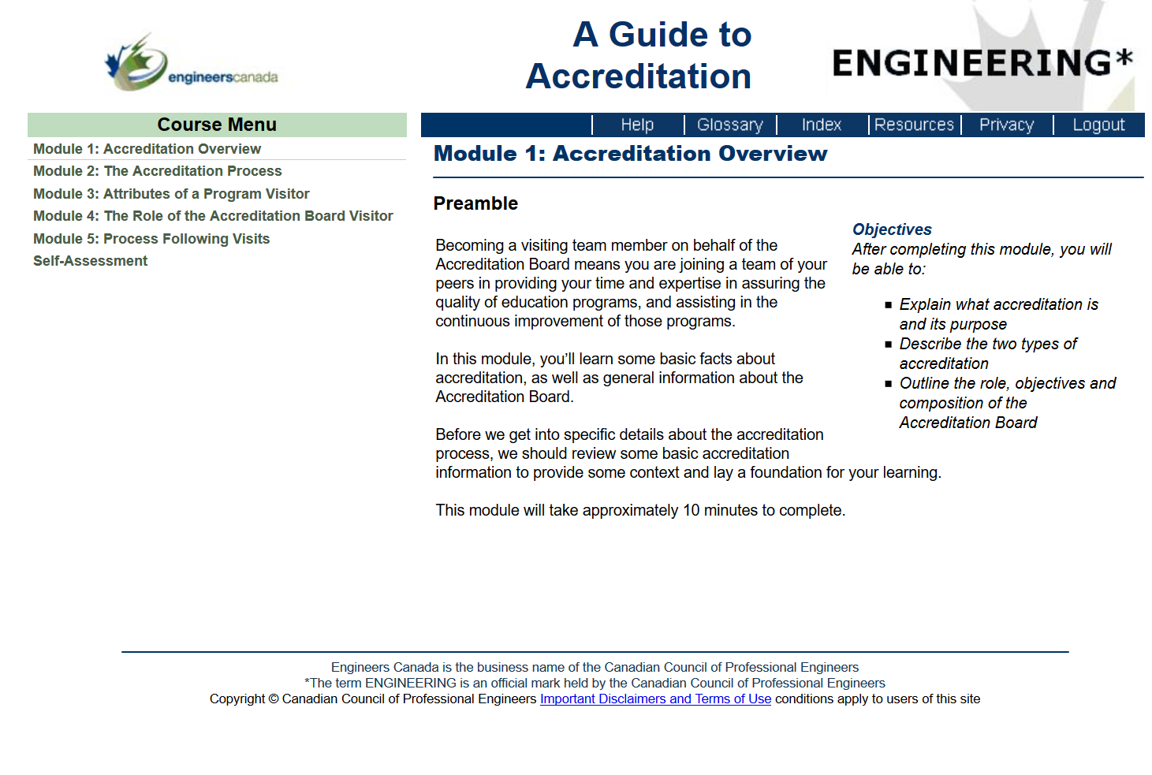
Training
Online training to be completed by each member of the team
  Login details provided by the CEAB Secretariat
  Overview of the accreditation process, roles and responsibilities, tips and tricks, etc.
Tandem training on navigating and using the system

Slide 27
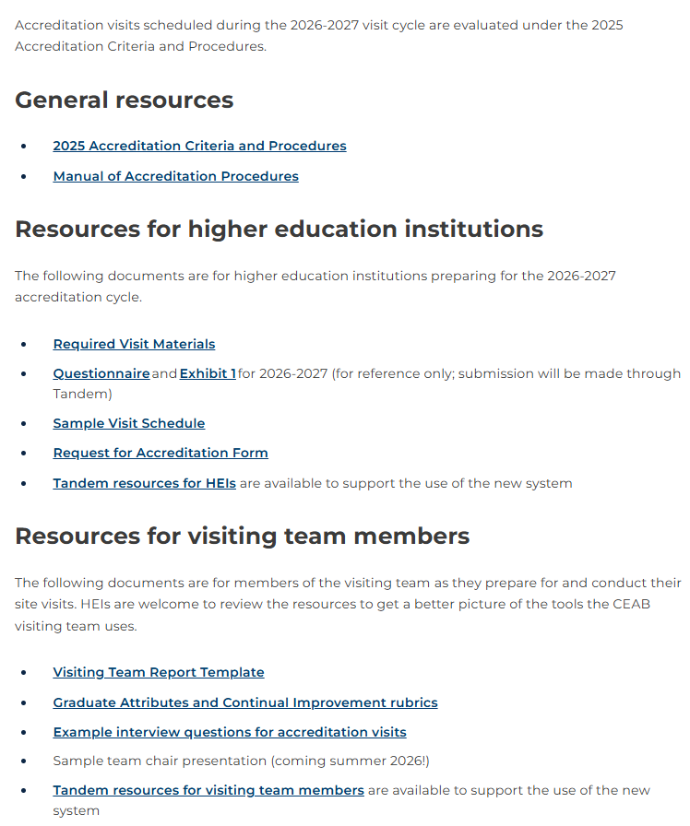
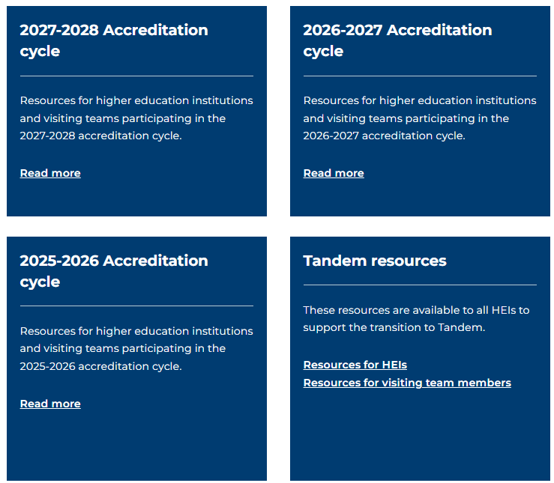
Team resources
Key documentation relative to the accreditation visit preparation is available on Engineers Canada public website: https://engineerscanada.ca/accreditation/accreditation-resources
Notes:
Tandem resources page
HEIs
User Guide
8 tutorials
2 webinars
2 training scenarios
Visiting teams
User Guide
6 tutorials
1 webinar
1 training scenario

Slide 28
Team member activities
Comply with Engineers Canada’s Board Code of Conduct.
Attend web meetings organized by the Team Chair
  The number and frequency of meetings as needed (usually 3-5)
  Getting to know the team
  General overview of process
  Identification of issues
  Planning visit schedule

Slide 29

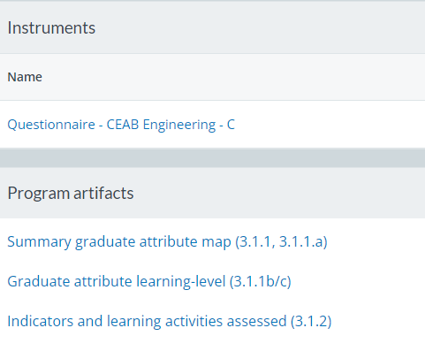
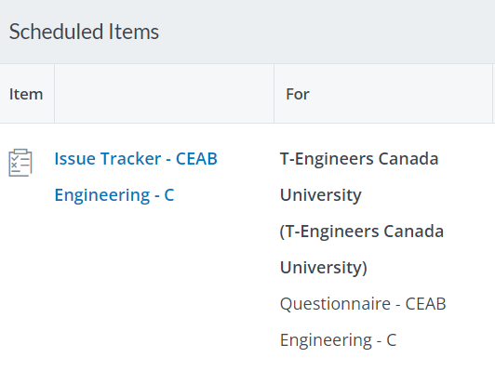
Team member activities
Individually review in Tandem the program’s
  Dashboard
  Course data and artifacts, which include, but are not limited to:
      Detailed syllabi
      Documentation of assigned work and assessment
      Evaluated student work
      Program’s components’ summary views
  Questionnaire, which now includes
      GA/CI detailed explanation
      Former Exhibit 1 document content
Complete the issue tracker directly in Tandem
  Identify issues for investigation during the visit
Notes:
Re: point #3: Program visitors are responsible for applying their discipline-specific knowledge to the criteria when assessing a program.
Re: point #4: the issue tracker is the former tracking of issues table which is now superimposed to the Questionnaire completed and submitted by the HEI. However, due to some inconsistencies that were reported, the team will be using an Excel version, that will be made available on an Engineers Canada SharePoint library

Slide 30
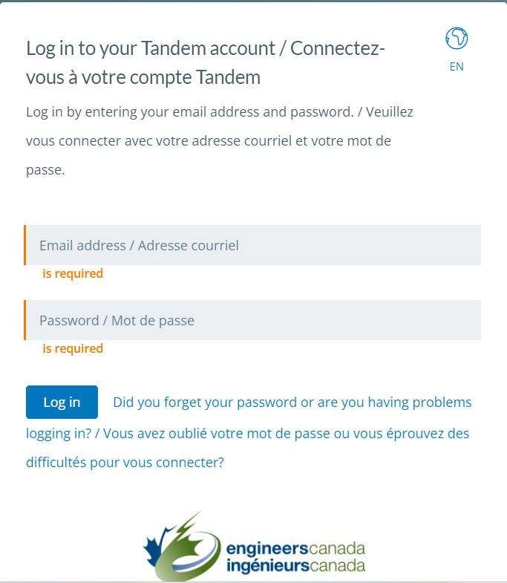
Accessing program materials
Program materials will be available in Tandem 8 weeks prior to the visit.
The CEAB Secretariat will send an invitation to each team member to access Tandem.

Slide 31
Accessing program materials, continued
“Sunday” materials to be made available ahead of visit (eight weeks before the visit start date):
      Program operational information
      GA/CI detailed explanation
      Detailed syllabi
      Documentation of assigned work and assessment
      Evaluated student work
      Evidence of a culture of safety
Notes:
Every effort should be made to identify any missing documentation in advance of the on-site visit
•Only documentation within the scope of the required visit materials list should be requested
•If you feel you need something in addition to what is detailed in the RVM, please consult with the visiting team chair and/or Engineers Canada staff (in the case where the chair is not available) before making a request.
For the materials traditionally made available to the visit team on-site on the Sunday preceding an in-person visit, the HEI must ensure visit team members have access to course materials and graduate attributes/continual improvement documentation, as described in the on-site materials section of the Questionnaire. These materials can be uploaded with the Questionnaire materials described above, or the HEI is welcome to post these materials on its own learning management system (LMS) to which they must provide direct links through Tandem. If programs are going to make materials available via their LMS or other internal platform, the HEI will be responsible for ensuring all visit team members have access to the platform if personalized accounts (originating from the institution) are required. These materials should be available eight weeks in advance of the visit.

Slide 32
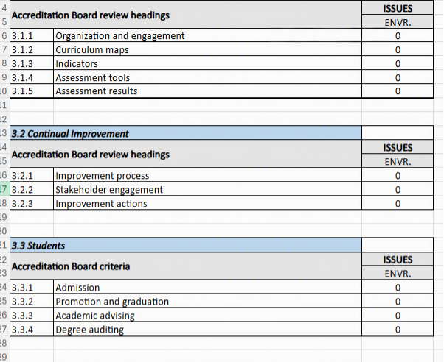
Issue tracker
Because the Roll Up Summary in Tandem returns inconsistent information from the program’s Issue Tracker, we will not use this feature.
Instead, an Excel Tracking of Issues worksheet has been provided.
Notes:
Team Chair will liaise with the Dean/Designated official to identify any issues before the team arrives on-site. This reduces the stress for the HEI and makes the visit more efficient. Sometimes more information will be provided by the program to the visitor, other times these discussions inform the development of the visit schedule. Openness and transparency with the HEI is key.
Note: The language of “met/not met” are terms reserved to the CEAB. Visiting team members are not identifying criteria that is met/not met, but rather flagging (via the *) a criterion for the CEAB’s further review. Engineers Canada staff are working with Tandem’s provider to resolve this issue.

Slide 33
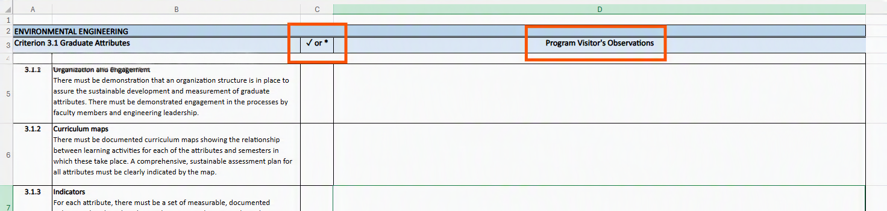
Issue tracker
Use this tool to record your findings based on your pre-visit and ongoing review of the institution’s questionnaire.
We will use this document to develop the site visit schedule and guide discussions while on-site.
When in doubt, consult with the Chair or Vice Chair.
Notes:
Team Chair will liaise with the Dean/Designated official to identify any issues before the team arrives on-site. This reduces the stress for the HEI and makes the visit more efficient. Sometimes more information will be provided by the program to the visitor, other times these discussions inform the development of the visit schedule. Openness and transparency with the HEI is key.
Note: The language of “met/not met” are terms reserved to the CEAB. Visiting team members are not identifying criteria that is met/not met, but rather flagging (via the *) a criterion for the CEAB’s further review. Engineers Canada staff are working with Tandem’s provider to resolve this issue.

Slide 34
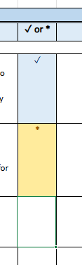
Identifying issues
The “minimum standard” is established by the criterion and (if one exists) further explained in the interpretive statement.
✓
Your options:
✓ = no observed issue on the criterion.
* = item flagged for CEAB review that, in the opinion of the visitor, has the potential to either jeopardize future compliance or currently prevents compliance with the criterion. Justification is required for * observations.
*
Notes:
Program visitors are responsible for applying their discipline-specific knowledge to the criteria when assessing a program.
General principles for comments in visiting team reports
1. A ✓ means that there is no observed issue on the criterion or that it is a numerical criterion which has a positive binary result.
A * means that the Program Visitor’s Observation field will contain a description of an observed item flagged for CEAB review that, in the opinion of the visiting team, has the potential to either jeopardize future compliance or currently prevents compliance with the criterion.
A comment has multiple audiences and purposes:
The Program; that allows them to understand the issue and questions the visitor had about compliance with a criterion, and allows them to formulate an appropriate response.
The Reviewer; that allows them to understand issues with meeting the criterion, so that they can formulate a motion to the CEAB.
The Team Chair, Editor and CEAB members; that allows them to clearly understand the issue.

Slide 35
Writing an observation
When a * is assigned, a detailed comment is required.
  a. Structure of comments:
    Reference the appropriate criterion language.
    State the evidence observed.
    State the way in which the evidence indicates a negative impact on the program.
  b. Comments should be precise and concise.
When a ✓ is assigned, do not comment.
Notes:
It is required that all visiting team members comply with this format.

Slide 36
Tips
Quantitative criteria are binary observations. Either the criteria have been met or not.
Avoid the terms “concern”, “weakness”, “deficiency” in your written comments
  These terms are reserved for CEAB accreditation decisions
The CEAB will discuss your findings at a decision meeting where a decision will be made as to whether the program’s compliance to criteria is acceptable, a concern, a weakness, or a deficiency.

Slide 37
The criteria

Slide 38
Accreditation criteria and procedures
The processes of accreditation place emphasis on the quality of the:
  Students
  Curriculum
  Academic staff/support staff
  Facilities and resources
Reminder: The onus is on the HEI to demonstrate compliance with the criteria.

Slide 39
About criteria and interpretive statements
Criteria
  Describe the measures used by the Accreditation Board to evaluate Canadian engineering programs for the purpose of accreditation.
Interpretive Statements
  Additional guidance on the interpretation and application of specific criteria.

Slide 40


Input and outcomes criteria: Why both?
Input criteria
Outcomes criteria
Prescribed exposure times to essential curriculum elements
Defines graduate attributes
ACCREDITATION DECISION
Enables easy calculation of the minimum path
Regular assessment of graduate attribute attainment drives continuous improvement
Notes:
Why BOTH input and outcomes criteria? For HEIs, they thought that we are going to be evolving from input measurement to outcomes assessment. But regulators like inputs. Retaining both, we think we can cut down on work from institutions. Washington Accord countries were all moving toward it so we needed to move with the trend to remain a member. WA membership is important for mobility of engineering. Regulators want this too (if someone applies for licensure from a WA country, there’s comfort there).
Demonstrate that we are doing both inputs and outcomes assessment which requires a whole lot less input data.
Our bosses are the regulators and they are very comfortable with input assessment. Outcomes has not replaced input. Where we are going, we are looking at process as opposed to results… to save HEIs time from proving to the AB that they are right.

Slide 41
Common issues identified
Program environment
Inadequate lab facilities and insufficient space (3.5.1.2)
Inadequate number of full-time faculty (3.5.2.1)
  Long-term leaves and long sabbaticals
  Soft-funded faculty
  Teaching loads ~ critical dependence on a single individual
Curriculum content and quality
Insufficient introduction to a culture of occupational health and safety (3.4.2)
AU adjustments to:
  natural sciences (3.4.3.2)
  engineering science (3.4.4.2)
  engineering design (3.4.4.5)
Notes:
This is not an exhaustive list.

Slide 42
Criteria highlights:
Curriculum content and quality
Measured by “Accreditation Units” (AU)
one hour of lecture (corresponding to 50 minutes of activity) = 1 AU
one hour of laboratory or scheduled tutorial = 0.5 AU
Three ways to measure curriculum:
  Traditional classroom and lab instruction measured by AUs (3.4.1.1)
  Non-contact hours, i.e. K-factor (3.4.1.3)
  Innovative engineering teaching methodologies with compelling rationale (3.4.1.4)
Notes:
Accreditation criteria are described in “Accreditation Criteria and Procedures 20xx”.
Assure the minimum path

Slide 43
Minimum curriculum components
Curriculum component | Minimum AUs | AUs To be taught by licensed faculty
Mathematics | 195 | -
Natural sciences | 195 | -
Mathematics and natural sciences combined | 420 | -
Engineering science | 225 | -
Engineering design | 225 | 225
Engineering science and engineering design combined | 900 | *600
Complementary studies | 225 | -
The program must have a minimum of 1,850 AUs
*For engineering science: Licensed faculty members or those within five years of their initial appointment, demonstrating progress towards processional engineering licensure
Notes:
A reduction from 1,950 AUs was implemented in the 2020 criteria book.
VERY IMPORTANT:
While criterion 3.4.6 states that the program must have a minimum of 1850 accreditation units, the AB does not require the program to EXCEED this minimum. The AB does not require or encourage programs to “cushion” their AU counts. If the program has 1850 AUs, the program has met criterion 3.4.6.

Slide 44
Criteria highlights:
Minimum curriculum components
AU allocation is not an exact science
  When reviewing course information and materials, consider whether AU allocations are reasonable?
All AU re-allocations are discussed with the visiting team
  An ongoing discussion on Sunday and Monday evening
You may discuss AU allocations with the responsible faculty member(s), but no need to argue
  Agree to disagree

Slide 45
Criteria highlights:
Professional licensure
Dean, Department Chairs, and faculty members teaching courses that are primarily engineering science or engineering design are expected to be licensed to practice engineering in Canada
  Criterion 3.4.4.4 minimum of 225AU of ED to be instructed by P.Eng./ing.
  Criterion 3.4.4.1 minimum of 600 AU of ES+ED to be instructed by P.Eng., ing., EIT, ing jr., other
Curriculum development and control should be in the hands of persons licensed to practice engineering in Canada
Notes:
Regarding the last point on the slide, note that some individuals in some Provinces will have a license to practice (limited) but not a P.Eng.

Slide 46
Criteria highlights:
Qualitative Evaluation – Curriculum Considerations
Curriculum must include the application of computers and appropriate laboratory experience and safety procedures
Students must be exposed to material dealing with professionalism, ethics, equity, public and worker safety and health considerations, concepts of sustainable development, environmental stewardship
The curriculum must prepare students to learn independently and to work as an effective member of a team

Slide 47
Criteria highlights:
Qualitative Evaluation – Curriculum Considerations
Curriculum must include studies in:
  communication skills
  engineering economics
  impact of technology on society
  subject matter that deals with central issues, methodologies and thought processes of humanities and social sciences, and;

Slide 48
Criteria highlights:
Qualitative Evaluation – Curriculum Considerations
Engineering Design:
  integration of curriculum elements
  creative, iterative and open-ended
  subject to constraints imposed by legislation or standards
  to satisfy specification using optimization
  economics should be part of the design experience
  to be supervised by licensed engineers
Every program must culminate in a significant design experience

Slide 49
Criteria highlights:
Graduate attributes
Two components
Attributes (criterion 3.1):
  Interpreted at time of graduation
  Recognized that achievement does not end there
  Program visitors evaluate the evidence and actions used to demonstrate the level of achievement of each graduate attribute
Continual Improvement (criterion 3.2):
  Ongoing evolution of engineering programs
  Processes needed:
    Assessment of attribute achievement
    Results used to improve program
  Program visitors evaluate the evidence and actions used to demonstrate the continual improvement achievement

Slide 50
Criterion 3.1 - “The institution must demonstrate that the graduates of a program possess the [12] attributes.”
Criteria 3.1.1 - 3.1.5 - Used to assess the suitability of a program for developing the graduate attributes.
3.1.1 Organization and engagement
3.1.2 Curriculum maps
3.1.3 Indicators
3.1.4 Assessment tools
3.1.5 Assessment results
Criteria 3.2.1 – 3.2.3 - Used to assess the institution’s continual improvement processes.
3.2.1 Improvement process
3.2.2 Stakeholder engagement
3.2.3 Improvement actions
Notes:
GA/CI criteria

Slide 51
Criteria highlights:
Graduate Attributes
A knowledge base for engineering
Problem analysis
Investigation
Design
Use of engineering tools
Individual and team work
Communication skills
Professionalism
Impact of engineering on society and the environment
Ethics and equity
Economics and project management
Life-long learning

Slide 52
Graduate Attributes:
Evaluation by the visiting team
Program Visitors can expect to see:
  Graduate Attributes (Accreditation Criteria)
  Learning outcomes that support Graduate Attributes
  Indicators
  Acceptable level of student (graduate) performance
  Feedback mechanism
A reminder that programs:
  Are assessed, not the students
  Are not required to assess every student, in every course, in every year
  Use the Graduate Attributes/Continual Improvement rubrics in your evaluation

Slide 53
Organization and engagement:
Rubric
✓ | Strong organizational structures and processes are in place that demonstrate the sustainable collection and assessment of GA data. AND clear evidence of engagement by most full-time faculty members and engineering leadership.
* | Weak or limited organizational structures and processes are in place. AND/OR no organizational structures and processes are in place. AND/OR limited or absent engagement of full-time faculty members and/or engineering leadership.
3.1.1
There must be demonstration that an organizational structure is in place to assure the sustainable development and measurement of graduate attributes.
There must be demonstrated engagement in the process by faculty members and engineering
leadership.

Slide 54
Curriculum maps:
Rubric
✓ | At least three learning activities for most graduate attributes are mapped. AND distributed across multiple semesters.
* | Less than three learning activities are mapped for many or most graduate attributes. AND/OR many graduate attributes are mapped over a limited number of semesters. AND/OR there are limited processes in place to evaluate the effectiveness of the mapping procedures
3.1.2
There must be documented curriculum maps showing the relationship between learning activities for each of the attributes
and the semesters in which these take place.
Notes:
Information in the curriculum map is:
Accurate, with some depth
Identifies intended outcomes from learning experiences
Not simply a list of topics “covered”
Map provides information for each attribute
Can include curricular and other experiences

Slide 55
Indicators:
Rubric
✓ | Measurable indicators describe and span the compliance requirements for each graduate attribute. AND are consistent with expected compliance learning levels for each graduate attribute. AND the number of indicators is consistent with a sustainable data collection program for each graduate attribute.
* | Measurable indicators do not adequately describe or span the compliance requirements of several or most graduate attributes. AND/OR are not consistent with expected compliance learning levels for several or most graduate attributes. AND/OR the number of indicators is not consistent with a sustainable data collection program for many or most graduate attributes.
3.1.3
For each attribute, there must be a set of measurable, documented indicators that describe what students must achieve in order to be considered competent in the
corresponding attribute.
Notes:
"GA component" – a component of the attribute description in section 3 of the “Accreditation Criteria and Procedures” (e.g. mathematics is a component of the knowledge base description)
"Performance Levels" – a scale of descriptors of the performance corresponding to an individual indicator. Performance levels for a coherent group of indicators corresponding to individuals are aggregated to measure graduate attribute achievement levels.
An indicator is like a sensor: what indicators has the program chosen?
Where have they placed their indicators? Where are the data collection points?
Does the data collection plan make sense? (i.e. Are Indicators well chosen? Are assessment points well chosen? Is valid, reliable data collection proposed? Is plan cyclic, continuous?)
Indicators align with attributes and questions
Indicators are “leading indicators”: central to attribute; indicate competency
Enough indicators defined to identify strength areas and weak areas within an attribute
Not too many indicators – resulting in reams of data but little deep information
Indicators are clearly articulated and measurable

Slide 56
Assessment tools:
Rubric
✓ | The nature and number of selected assessment tools for the learning levels for each graduate attribute is reasonable. AND the rationale for their selection is well documented.
* | The nature and number of selected assessment tools for the learning levels for several or most attributes is not reasonable. AND/OR the rationale for the selection of the assessment tools is not well documented. AND/OR the rationale for the selection of the assessment tools is not documented.
3.1.4
There must be documented assessment tools that are appropriate to the attribute and used as the basis for obtaining data on student learning with respect to all twelve attributes over a cycle of six years or less.
Notes:
On what does the program propose collecting data (i.e. indicators)? What methods are proposed for collecting data?
Learning is generally demonstrated through:
Artifacts, e.g. written test, report, built project
Performances, e.g. oral presentation, observed practice
Indicators are well aligned to the proposed assessment points
Enough assessment points are utilized
Expectations of performance quality are clear, i.e. the scale is defined
Definitions:
Valid Indicators measure what they are supposed to measure
Reliable Indicators the results are consistent; the measurements are the same when repeated with the same subjects under the same conditions
Direct measures directly observable or measurable assessments of student learning
Indirect measures opinion or self-reports of student learning or educational experiences
Use both direct and indirect measures if possible.

Slide 57
Assessment tools:
Examples
Examinations
      Final
      Mid-term
      Entry and exit
      Standardized (PPE, FE)
      Oral
      Embedded questions
Portfolios
      Culminating design experience
      Projects
      Laboratories
      Internship/stage
      Co-op
Surveys
      Exit
      Alumni
      Employers
      Self
      Course Evaluations
      Advisory Board
Student Work
      Reports
      Peer Reviews
      Reviews/critiques
      Presentations
      Posters

Slide 58
Assessment results:
Rubric
✓ | Assessment results are compiled and documented for all graduate attributes over a period of six years or less. AND At least three learning activities for most graduate attributes are assessed. AND results demonstrate that the graduate cohort has achieved the HEI compliance requirements for most graduate attributes OR that remedial action is in progress.
* | Assessment results are compiled and documented for most graduate attributes over a period of six years or less. AND/OR assessment results have not been compiled or documented for most attributes over a period of six years or less. AND/OR Less than three learning activities for some graduate attributes are assessed. AND/OR many graduate attributes are assessed over a limited number of semesters. AND/OR results demonstrate that the graduate cohort has not achieved the HEI compliance requirements for most graduate attributes OR no remedial actions are being taken. AND/OR the processes are in place but not consistently applied by all participants in the process.
3.1.5
At least one set of assessment results must be obtained for all twelve attributes over a period of six years or less. The results should provide clear evidence that the graduates of a program possess the attributes or that
remedial action is in progress.

Slide 59
Continual improvement:
The big picture
At a high-level, programs are expected to continually evaluate and improve where necessary;
There must be processes in place that demonstrates that program outcomes are being assessed in the context of the graduate attributes
  Are students meeting expectations?
  In what areas are students successful?
  What areas of the program require improvement?

Slide 60
Continual improvement
The feedback loop
If observed outcomes are not consistent with expected attributes, then system inputs and/or process must be adjusted.
Program
outcomes evaluated
Changes planned (curriculum, courses, performance metrics, etc.)
Changes implemented
Data
collection
and
evaluation
Plan. Do. Check. Act

Slide 61
Improvement process:
Rubric
✓ | Adequate continual improvement processes are in place that demonstrate program outcomes are being assessed and applied to the further development of the engineering program AND clear evidence of engagement by most full-time faculty members and engineering leadership.
* | Absent or limited continual improvement processes are in place that demonstrates program outcomes are being assessed and applied to the further development of the engineering program AND/OR process is not adequately documented AND/OR limited or absent engagement of full-time faculty members and/or engineering leadership.
3.2.1
There must be processes in place that demonstrate that program outcomes are being assessed in the context of graduate attributes and applied to further development of the program.
Notes:
Triangulation in improvements process:
Are opportunities included for informal assessment, students’ self-reports of learning, and even unsolicited data from placement supervisors or employers?
Are more than one type of assessment used when analyzing data?
Are all assessments valued, not just major events?
Are the data gained from assessment used to answer questions about authentic learning?
Are data across time intervals looked at?

Slide 62
Stakeholder engagement:
Rubric
✓ | Internal and external stakeholders are broadly selected (e.g. internal: students, program faculty, engineering and/or nonengineering faculty; external: alumni, engineering professionals, other professionals, employers, learned societies, etc.) AND stakeholder roles in the improvement process are adequately demonstrated.
* | Internal and external stakeholders are narrowly or insufficiently selected. AND/OR stakeholder roles in the improvement process are inadequately demonstrated or are not specified
3.2.2
There must be a demonstrated engagement of stakeholders both internal and external to the program in the continual improvement process.

Slide 63
Improvement actions:
Rubric
3.2.3
There must be a demonstration that the continual improvement process has led to consideration of specific actions corresponding to identifiable improvements in the program and/or its assessment process. Note, if the evidence suggests no change is warranted, then no change is necessary. This criterion does not apply to new programs.
✓ | Following decisions for improvement, evidence-based program-level and/or assessment process improvement actions have been implemented (if change was necessary) AND timelines and accountability for implementation have been documented.
* | Despite decisions for change, only a limited number of or no evidence-based program-level and/or assessment process change actions have been implemented (if change was necessary). AND/OR no timelines or accountability for implementation have been established.

Slide 64
GA/CI myth busting
Myth | Truth
Employer surveys cannot be used to assess Graduate Attributes. | Programs can use employer surveys to assess Graduate Attributes. Employer surveys are an acceptable assessment tool.
CEAB accreditation criteria does not allow non-engineers to take engineers courses. | The criteria do not define which students are permitted to take which courses. If non-engineering student data is included in GA/CI evaluation processes, the data may be skewed.

Slide 65
3.5.1.2d: Non-academic counselling and guidance other supporting facilities and services
3.5.1 is concerned with the “Quality of the educational experience”
  Major importance is attached to the quality of the educational experience
Assess existence and knowledge of available resources, NOT the quality of mental health services
See the Example interview questions for accreditation visits document
Notes:
Some suggested questions to ask students include:
How do students access non-academic advising and other support services?
Is career counselling available, and who provides it?

Slide 66
Recent relevant changes -
To criteria, procedures, tools

Slide 67
General Visitor’s role removed
Previously:
  One or two per visit
  Appointed by the provincial regulator
  Evaluates occupational health and safety aspects of the curriculum (safety, student projects, support departments and facilities)
  Reports findings to the regulator
Beginning with the 23/24 visit cycle:
  Regulators have decided not to appoint GVs
  Regular feedback on the system has noted that this role has not been an effective way to use volunteer time
  Regulators may send observers instead
General Visitor(s)

Slide 68
Update to required visit materials
The general instructions have been updated to reflect the new list of visit materials that programs are required to prepare for a visit.
Save time for HEI and Visiting Team
Provide transparent, consistent messaging
Move to risk-based assessment
  Minimum Path
  Students
Notes:
Minimum Path: the set of Learning Activities which provide the least number of Accreditation Units (AUs) within each Canadian Engineering Accreditation Board curriculum component, calculated based on Course Information Sheet input. The Minimum Path calculation assumes the student chooses courses with the lowest number of Engineering Science or Engineering Design AUs, which may require the student to complete more Elective Learning Activities than the minimum number M specified by the program to meet the Criteria specifications, particularly if a Program offers a significant number of Elective Learning Activities with low Engineering Science or Engineering Design AUs.
Distinct from:
Shortest Graduation Path: the smallest set of Learning Activities a student needs to complete to be granted a degree from a program.
If the Program meets all AU minima in Core Learning activities, the Shortest Graduation Path includes the Core Learning Activities and any M Elective Learning Activities.
If the Program requires Elective Learning Activities to meet AU minima, and the Program has internal mechanisms to constrain Elective Learning Activities to ensure AU minima are met, the Shortest Graduation Path includes the Core Learning Activities and M Elective Learning Activities that follow the constraints.
If the program requires Elective Learning Activities to meet AU minima, and has no internal mechanisms to constrain Elective Learning Activities to ensure AU minima are met, the Shortest Graduation Path includes the Core Learning Activities and the Elective Learning Activities calculated by the Minimum Path.

Slide 69
Update to required visit materials
The general instructions have been updated to reflect the new list of visit materials that programs are required to prepare for a visit.
Required visit materials – Due 8 weeks before the visit
A. Program Operational Information (information provided in the questionnaire and associated documents before the visit, links to documents are accepted)
B. Graduate Attributes and Continual Improvement Detailed Explanation (information given at a presentation or during the visit)
C. Detailed Syllabi (electronic form)
D. Documentation of Assigned Work and Assessments (electronic form when possible)
E. Evaluated Student Work (electronic form when possible)
F. Evidence of a Culture of Safety
Notes:
Every effort should be made to identify any missing documentation in advance of the on-site visit
•Only documentation within the scope of the required visit materials list should be requested
•If you feel you need something in addition to what is detailed in the RVM, please consult with the visiting team chair and/or Engineers Canada staff (in the case where the chair is not available) before making a request.
C. Detailed Syllabi (Criteria 3.1, 3.4)​
Course Syllabi and additional information as required should be provided in electronic form, at a time agreed upon by the Visiting Team Chair and the Program.​
For Core Activities satisfying the Mathematics and Natural Sciences AU requirements, provide course syllabi.​
For Core and Elective Activities satisfying the Engineering Science and Engineering Design AU requirements, provide a week-by-week (or equivalent) description of course content and learning outcomes, indicating engineering tool use and lab experience. ​
For Core Activities satisfying the Complementary Studies or Other AU requirements, provide references or links to calendar descriptions; a week-by-week (or equivalent) description of course content is not required. If calendar descriptions don't provide clear evidence of humanities, social sciences, arts, languages, management, engineering economics, or communication content, detailed course syllabi including learning outcomes must be provided.​
For Core and Elective Activities taught outside the Faculty of Engineering (or equivalent) that directly support evidence of Graduate Attributes and are not covered in items C.1 to C.3, provide a detailed, week-by-week (or equivalent) syllabi of course content and expectations, indicating engineering tool use and lab experience.
D. Documentation of Assigned Work and Assessments (Criteria 3.1, 3.4.4, 3.4.6, 3.4.7)​
Document the assigned work and assessments of the Program’s Learning Activities on the Shortest Graduation Path claiming Engineering Science or Engineering Design Accreditation Units. This information should be provided in electronic form when possible, at a time agreed upon by the Visiting Team Chair and the Program.​
Provide problem set questions. If questions are from a textbook, provide the text or copies of the questions.​
Provide laboratory information given to students, as well as detailed marking schemes or detailed rubrics for the Program’s Learning Activities on the Shortest Graduation Path. When detailed marking schemes or detailed rubrics are not available, submit up to six samples of marked laboratory work. These samples must include at a minimum three examples of work that in the opinion of the instructor(s) marginally meet expectations at the time of assessment. If all work meets expectations, provide at least three works that, in opinion of the instructor(s), are the lowest quality products.
Provide project descriptions with detailed marking schemes or detailed rubrics for the Program’s Learning Activities on the Shortest Graduation Path. When detailed marking schemes or detailed rubrics are not available, submit up to six samples of marked project work. These samples must include at a minimum three examples of work that in the opinion of the instructor(s) marginally meet expectations at the time of assessment. If all work meets expectations, provide at least three works that, in the opinion of the instructor(s), are the lowest quality products. ​
Provide quizzes, tests, exams, and other summative assessments with detailed marking schemes or detailed rubrics, if available for the Program’s Learning Activities on the Shortest Graduation Path.
E. Evaluated Student Work (Criteria 3.1, 3.4.4, 3.4.6, 3.4.7)​
Evaluated student work should be provided in electronic form when possible, at a time agreed upon by the Visiting Team Chair and the Program.​
​
For culminating design experiences, provide all student deliverables from ten evaluated projects, including, but not limited to, written reports, physical models, or mathematical models as appropriate. If less than ten projects were completed in the course, include all projects. These samples must include at a minimum, three examples of work that in the opinion of the instructor marginally meet expectations at the time of assessment. If all work meets expectations, provide at least three works that, in the opinion of the instructor(s), are the lowest quality products.
2. For ten Core Learning Activities providing Engineering Science and Engineering Design AUs (other than the Engineering Design Culminating Experiences) taken by all students in the program in the final two years of study, provide exams, quizzes, tests, or other summative assessments that are worth in any combination at least seventy-five per cent of the total mark in the Core Learning Activity. For each assessment, up to six samples may be submitted. These samples must include at a minimum three examples of work that in the opinion of the instructor marginally meet expectations. If all work meets expectations, provide at least three works that, in the opinion of the instructor(s), are the lowest quality products.
3. If the Program requirements for the final two years of study consist of fewer than ten Core Learning Activities, the Program can choose to submit Core Activities in the previous year of study, or high enrolment Elective Learning Activities on the Shortest Graduation Path in the final years. The Program should provide sufficient information to demonstrate compliance to the Criteria.
4. Provide additional examples of performance in Graduate Attributes that have not been included in the culminating design experience (E.1) or the ten learning activities selected in E.2 and E.3 so that at least one sample set related to each of the Graduate Attributes is available. These examples should be taken from courses on the Shortest Graduation Path at an intermediate development (D) or advanced application (A) level. Up to six examples may be provided to support compliance to each of the Graduate Attributes not addressed in E1, E2, or E3, but they must include at least three examples of work that, in the opinion of the instructor(s) at the time of marking, marginally meet expectations.
F. Evidence of a Culture of Safety (Criteria 3.4.7)​
Evidence of a culture of safety should be available at the visit, including, but not limited to safety manuals, documentation of training provided to students, safety meeting minutes, records, and signage.

Slide 70
Temporary exemption for students going on international exchange
A situation-limited policy introduced for 23/24
  Intended to remove accreditation barriers to students going on international exchange
  Will be re-evaluated in June 2027
  Any re-evaluation will take into consideration the outcomes of Engineers Canada’s 2022-2024 Strategic Priority 1.1
Impacted criteria:
  3.3.1 Admission
  3.3.2 Promotion and graduation
  3.4.4.1: 600 AUs of engineering science and engineering design
  3.4.4.4: 225AUs of engineering design
  3.4.8: Satisfying all requirements for curriculum content
  3.5.5: Professional status of faculty members
  Appendix 1: Regulations for granting of transfer credits
Notes:
The Temporary Exemption for Students Going on International Exchange is a situation-limited policy intended to remove accreditation barriers to students enrolled in undergraduate engineering programs at Canadian Higher Education Institutions (HEIs) going on International Exchange as part of their degree program.
This Temporary Exemption addresses accreditation barriers to students going on International Exchange, including those criteria relating to the curriculum content that must be delivered by faculty members licensed to practice engineering in Canada, and the percentage of a program that must be completed at the Home Institution.
6 CEAB Accreditation Criteria and Procedures Considered Under this Temporary Exemption
Several CEAB Accreditation Criteria and Procedures have been identified which are affected by this Temporary Exemption:
Criterion 3.3.1 Admission: There must be documented processes and policies for admission of students. Admission involving advanced standing, prior studies, transfer credits and/or exchange studies must be in compliance with the associated Accreditation Board regulations…
The Temporary Exemption applies only to undergraduate engineering students going on International Exchange. Advanced standing, prior studies, and transfer credits for admission of students are outside the scope of this exception.
Criterion 3.3.2 Promotion and graduation: Processes and policies for promotion and graduation of students must be documented. The institution must verify that all students have met all its regulations for graduation in the program identified on the transcript and that the curriculum followed is consistent with that of the accredited program. The program name must be appropriate for all students graduating from the program.
Engineering programs with students on International Exchange are required to implement and adhere to the processes and procedures specified in Section 7. The Home Institution’s International Exchange Processes and Procedures must be submitted for review by the accreditation visiting team.
Criterion 3.4.4.1 A minimum of 600 Accreditation Units (AU) of a combination of engineering science and engineering design curriculum content in an engineering program shall be delivered by faculty members holding, or progressing toward, professional engineering licensure as specified in the Interpretive statement on licensure expectations and requirements.
International Exchange is exempt from this criterion if the verification process and procedures referenced in Section 7 are followed.
Criterion 3.4.4.4 A minimum of 225 AU of engineering design curriculum content in an engineering program shall be delivered by faculty members holding professional engineering licensure as specified in the Interpretive statement on licensure expectations and requirements.
International Exchange is exempt from this criterion if the verification process and procedures referenced in Section 7 are followed.
Criterion 3.4.8 The requirements for curriculum content must be satisfied by all students, including those claiming advanced standing, credit for prior post-secondary-level studies, transfer credits, and/or credit for exchange studies.
International Exchange is exempt from this criterion if the verification process and procedures referenced in Section 7 are followed.
Criterion 3.5.5 Professional status of faculty members: Faculty delivering curriculum content that is engineering science and/or engineering design are expected to be licensed to practise engineering in Canada…
International Exchange is exempt from this criterion if the verification process and procedures referenced in Section 7 are followed.
Appendix 1: Regulations for granting of transfer credits 1.4: There are no restrictions on transfers of credits among Accreditation Board-accredited programs; however, in all cases at least 50% of the program shall be completed at the home institution.
For International Exchange Students, this criterion is relaxed: at least 50% of the program must be completed at CEAB-accredited programs in Canada. Credits transferred based on domestic studies from programs abiding by the CEGEP credit transfer and feeder-institution credit transfer protocols described in Appendix 1 the CEAB Accreditation Criteria and Procedures will be considered part of a CEAB-accredited program.
Appendix 1: Regulations for granting of Transfer Credits clause 2.4.1: If transfer credit is granted for engineering science or engineering design, the home institution must verify, for example through a formal agreement, that the expertise, competence and professional status of the faculty are substantially equivalent to those of faculty delivering accredited programs in Canada;
International Exchange is exempt from this clause if the verification process and procedures referenced in Section 7 are followed.
Appendix 1: Regulations for granting of Transfer Credits clause 2.4.3: For transfer credits not covered under clause 2.4.1 [formal agreement between the home and exchange institution] or clause 2.4.2 [substantially equivalent programs, Washington Accord signatories, jurisdictions with which Engineers Canada has a mutual recognition agreement], at least 600 AU of engineering science and engineering design (combined) and at least 225 AU of engineering design must be completed at and credit granted by the home institution.
International Exchange is exempt from this clause, but International Exchange Students are still subject to criterion 3.4.4 (A minimum of 900 AU of a combination of engineering science and engineering design: Within this combination, each of Engineering Science and Engineering Design must not be less than 225 AU). However, an International Exchange Student is not required to acquire these AUs at their Home Institution if the verification process and procedures referenced in Section 7 are followed

Slide 71
Expectations for the program: Documented international exchange processes and procedures
Processes and procedures to assess learning activities taken at a host institution:
  The Home Institution must verify and provide evidence that the academic level of the Learning Activity for which credit is granted is equal to or above the academic level of the engineering program at the Home Institution.
  The Home Institution must assess a list of proposed Learning Activities to be taken for each International Exchange Student.
  The Home Institution must have documented processes and procedures to verify that Host Institution Learning Activities for which transfer credits are granted carry at least the same number of AUs as the Home Institution leaning activities as per CEAB curriculum content categories.
  The Home Institution’s processes and procedures must be made available to the accreditation visiting team.
Notes:
7 International Exchange Processes and Procedures
The Home Institution must document the International Exchange Processes and Procedures. To implement the Temporary Exemption, the Home Institution’s existing processes and procedures to evaluate transfer credits can be used.
7.1 Processes and Procedures to assess Learning Activities taken at a Host Institution
CEAB Accreditation Criteria and Procedures – Appendix 1, Regulation 1.2 requires the Home Institution to verify and provide evidence that the academic level of the Learning Activity for which credit is granted is equal to or above the academic level of the engineering program at the Home Institution. In addition, under this temporary exemption, the following processes and procedures apply:
The Home Institution must assess a list of proposed Learning Activities to be taken for each International Exchange Student. Learning Activity equivalencies must be assessed by relevant Home Institution program representative(s) (program director, equivalent, or designate) in collaboration with other faculty members with specialized disciplinary knowledge, as required. Proposed Learning Activities to be taken on International Exchange do not need to be mapped to Learning Activities at the Home Institution on a one-to-one basis. Rather, the suite of Learning Activities to be taken on International Exchange will be evaluated for substantial equivalency on how it meets the specific program requirements for accreditation.
The Home Institution must have documented processes and procedures to verify that Host Institution Learning Activities for which transfer credits are granted carry at least the same number of AUs as the Home Institution leaning activities as per CEAB curriculum content categories Mathematics, Natural Sciences, Engineering Science, Engineering Design, and Complementary Studies. In the case of Host Institution Learning Activities with Engineering Science and/or Engineering Design content, a Home Institution program representative who is licensed to practice engineering in Canada must attest that the Host Institution Learning Activities are substantially equivalent to the Home Institution’s Learning Activities.
7.2 Requirements for an Accreditation Visit
The Home Institution’s processes and procedures as required by section 7.1 must be made available to the accreditation visiting team.
A description of the review process, including an indication of the person(s) responsible for signing off on Learning Activities and/or program equivalencies for the granting of transfer credits obtained on an International Exchange must be available to the visiting team. The responsible individual(s) must be prepared to describe and discuss the review process during the accreditation visit. Up to three examples of relevant documentation to demonstrate this process must be made available to the visiting team.

Slide 72
Expectations for the program:
Addendum to the Questionnaire
Evidence to be provided if the Temporary Exemption is being used:
  The processes and procedures for students going on international exchange
  A description of the review process, including information on who signs off on learning activities/program equivalences for granting transfer credits
  Up to three examples of documentation to demonstrate the review process
  The responsible individual(s) must be prepared to discuss the processes and procedures with the visiting team
Notes:
Optional addendum
Programs hosting visits in the 2023/2024 cycle that wish to incorporate the new policy into their operations are required to submit to the visiting team, with their Questionnaire submission:
The Home Institution’s processes and procedures as required by section 7.1 of the Temporary Exemption for Students Going on International Exchange.
A description of the review process, including an indication of the person(s) responsible for signing off on Learning Activities and/or program equivalencies for the granting of transfer credits obtained on an International Exchange.
Up to three examples of relevant documentation to demonstrate the review process.
The responsible individual(s) must be prepared to describe and discuss the review process during the accreditation visit.

Slide 73
2026-2027 Documentation
Focus on GA/CI process: Summary of changes
“Exhibit 1” – now part of the Questionnaire
  Select 3 – 5 courses (or learning activities) used to assess achievement of each GA. For each course, discuss curriculum maps, indicators, and assessment tools.
  Discuss assessment results for each Graduate Attribute.
Questionnaire
Reduces the on-site “Graduate Attributes Dossier” by focusing on three examples where change to a program was considered rather than ALL data for ALL changes.
On-site GA/CI presentation: Describe overall GA/CI process; reflection on what’s working and what’s not working on the GA/CI process.
Notes:
Exhibit 1:
Documentation submitted in advance of the visit focuses on GA/CI process and not on data.
Reduces the documentation required (before, we asked for data related to EACH COURSE. Now we are asking for samples).
We are focusing more on process and less on data. The data demonstrates the execution of a process.
Questionnaire:
Changes to “GA dossier”
Current instructions are vague; results in a LOT of data/documentation on-site
New GA/CI onsite documentation instructions are more clear, more focused on what the visiting team really needs to evaluate the PROCESS
Rubrics:
GA / CI rubrics guides the visiting team on how to assess the GA / CI criteria.
Helps the team describe their findings to the CEAB.

Slide 74
Interpretive statement changes
2020 Interpretive statement on licensure expectations and requirements | 2021 Interpretive statement on licensure expectations and requirements
Clause 8 In order to ensure that engineering science, engineering design, natural science, mathematics and complementary studies curriculum contents are readily and easily identifiable, each course in an engineering program should be described using a maximum of three curriculum categories (ES, ED, NS, Math, CS) with no single category constituting less than 8 AU’s or 25% of the total AU for a particular course. Clause 9 It is up to the institution offering the program to justify the unique aspects of any course that deviates from clause 8. | Clause 8 Engineering science, engineering design, natural science, mathematics, and complementary studies curriculum content should be readily and easily identifiable through learning outcomes, learning activities and assessments attributable to each category in each course where they appear. Clause 9 Removed.
Notes:
Working with the EDC, the P&P and CEAB sought to modernize the Interpretive statement on licensure expectations and requirements by removing caps on the minimum requirements for AUs in a course that can be counted. This respects current pedagogical practices that see content threaded throughout programs and courses for maximum impact for students.

Slide 75
New Interpretive Statement on Engineering Design
The Accreditation Board develops interpretive statements to clarify the intent underlying certain key expectations which generate inquiries that are not otherwise covered by the Accreditation board criteria. The Interpretive Statement on Engineering Design offers clarity on the definition as it relates to criterion 3.4.4.5 and Graduate Attribute 4.
It defines what Engineering Design is and what it is not and provides concrete examples.
This statement resulted in criteria 3.1 and 3.4.4.5 to be updated as follows.

Slide 76
Criteria changes – Definition of design
2022 Criterion 3.1 | 2023 Criterion 3.1
Graduate attribute #4: Design An ability to design solutions for complex, open-ended engineering problems and to design systems, components or processes that meet specified needs with appropriate attention to health and safety risks, applicable standards, and economic, environmental, cultural and societal considerations. | Graduate attribute #4: Design The ability to perform engineering design. Engineering design is a process of making informed decisions to creatively devise products, systems, components, or processes to meet specified goals based on engineering analysis and judgement. The process is often characterized as complex, open-ended, iterative, and multidisciplinary. Solutions incorporate natural sciences, mathematics, and engineering science, using systematic and current best practices to satisfy defined objectives within identified requirements, criteria and constraints. Constraints to be considered may include (but are not limited to): health and safety, sustainability, environmental, ethical, security, economic, aesthetics and human factors, feasibility and compliance with regulatory aspects, along with universal design issues such as societal, cultural and diversification facets.

Slide 77
Criteria changes – Definition of design
2022 Criterion 3.4.4.5 | 2023 Criterion 3.4.4.5
A minimum of 225 AU in engineering design is required. Engineering design integrates mathematics, natural sciences, engineering sciences, and complementary studies in order to develop elements, systems, and processes to meet specific needs. It is a creative, iterative, and open-ended process, subject to constraints which may be governed by standards or legislation to varying degrees depending upon the discipline. These constraints may also relate to economic, health, safety, environmental, societal or other interdisciplinary factors. | A minimum of 225 AU in engineering design is required. Engineering design is a process of making informed decisions to creatively devise products, systems, components, or processes to meet specified goals based on engineering analysis and judgement. The process is often characterized as complex, open-ended, iterative, and multidisciplinary. Solutions incorporate natural sciences, mathematics, and engineering science, using systematic and current best practices to satisfy defined objectives within identified requirements, criteria and constraints. Constraints to be considered may include (but are not limited to): health and safety, sustainability, environmental, ethical, security, economic, aesthetics and human factors, feasibility and compliance with regulatory aspects, along with universal design issues such as societal, cultural and diversification facets.

Slide 78
The visit
A fact-finding exercise

Slide 79
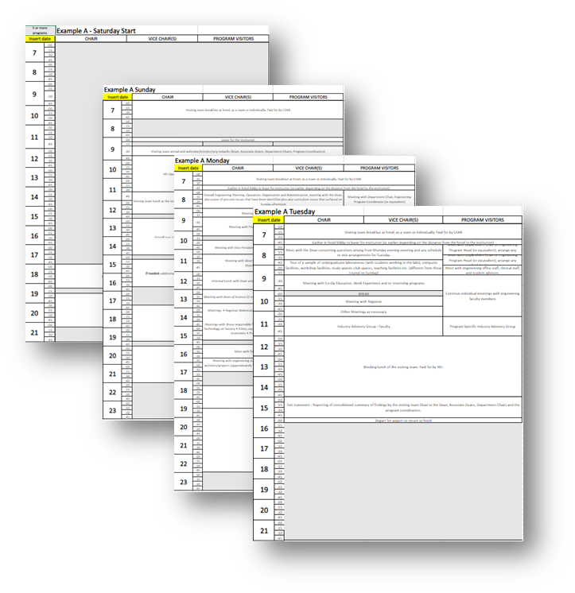
Overview
2.5 - 3 days
  Sunday, Monday, Tuesday
  October-November - existing programs
  January-February - new programs
3 Objectives:
  Validate and seek clarification of program(s) details based on a review of the institution’s completed Questionnaire.
  Gather information about the program(s) and assess evidence of compliance with criteria
  Evaluate the measures taken to resolve issues raised previously by the Accreditation Board regarding the program(s) (if applicable).
  Example of visit schedule – Engineers Canada website
Notes:
The visits generally start on Sunday with the GA/CI presentation from the program, but the pre-visit Saturday meeting is at the discretion of the Team Chair. is likely to be cancelled given the pre-visit team meetings that will have been scheduled.
Some meetings are optional, based on the visiting team and HEI’s needs. On their first pre-visit teleconference, the visiting team chair is encouraged to discuss with team members which of the optional meetings should be included in the visit schedule. The primary objective of the visit is to validate and seek clarification of program details based on the team’s review of the institution’s Questionnaire. The team members should reflect on information they need from any individual to perform their assessment of the institution’s compliance with the CEAB criteria and the schedule should be built to achieve this objective.

Slide 80
Interviews:
Tasks and tools
“Trust then verify”
Interviews with:
  Senior administrative officers (i.e. president, dean of engineering, the program chairs, etc.)
  Faculty
  Students
  Support staff
Areas to explore evidence of:
  compliance with graduate attribute criteria
  professional attitudes
  motivations
  morale
  the balance of opinions concerning theoretical and practical elements of the curriculum
Notes:
In carrying out the tasks listed on this slide, “Example interview questions for accreditation visits” is a helpful resource, along with the description of accreditation criteria given in “Accreditation Criteria and Procedures”.
Program visitors are not expected to ask each question, verbatim. Instead, visiting team members should consider the questions they might wish to ask of the program while reviewing the questionnaire materials. The Guide is not meant to be a checklist, it is meant to be a tool to help program visitors triangulate the visit data.
The questions that will be asked during the site visit relate to areas where the team needs more information in order to document their findings, areas requiring additional information. If questions are not asked about a specific area or initiative, it does not signal a lack of interest on the CEAB’s part.

Slide 81
Tours: Tasks and tools
Evaluate the effectiveness of facilities such as:
  laboratories
  libraries
  computing facilities
The Accreditation Board does not require Faculty to spend money
  Visitors investigate whether the equipment, supplies, etc. are adequate
Program materials to determine whether performance expectations and grading standards are appropriate. For example:
  examination papers
  laboratory instruction sheets
  student transcripts
  student reports and theses, models or equipment constructed by students
  other evidence of student performance
Notes:
For tasks related to review of program material, program visitors refer to their own experience of course materials.
Chair and Vice-Chair, in examining transcripts, can refer to “Accreditation Criteria and Procedures”, including the “Regulations for granting transfer credits”.

Slide 82
Visit Schedule
Schedule is built based on the needs of the visiting team and HEI using the CEAB sample
Specific meetings suggested for each visiting team member (Chair, Vice-Chair, Program Visitor)
Day 0 (Saturday) optional‏
  Revision of the issue tracker;
  Tips about how to conduct an interview;
  Tips about how to write an observation;
  Building team dynamic;
  Calibrate on common core and common GA/CI observations across all programs
  Example of visit schedule – Engineers Canada website

Slide 83
Visit Schedule cont’d.
Day 1 (Sunday)‏
Team pre-visit meeting
Meet with program officials
Graduate attribute/continual improvement presentation*
Tour of engineering facilities, including samples of laboratories, study spaces, club spaces, teaching facilities etc.
Team meeting to discuss:
  previous decision issues and areas to be re-examined
  observations and findings
  potential issues that warrant further investigation
Day 2 (Monday)‏
Interviews with dean, upper administrators, faculty, support services, students, etc.
Additional tours, as needed
Team evening meeting to build consensus around:
  areas of strength
  issues that require further investigation
Notes:
Team members will together review the combined list of potential issues that they have separately developed using the issue tracker in Tandem.
Team members each revise their preliminary draft of their contribution to the “CEAB Visiting Team Report”.
*This presentation is dependent on the preference of the program. They may submit it electronically in advance, or deliver it live.

Slide 84
Visit Schedule cont’d.
Day 3 (Tuesday)‏
Update with Dean
Interview with industry/program advisory group
Wrap-up interviews and tours
In camera Team Working Lunch:
  Complete each program’s issue tracker
  Arrive at consensus on final conclusions
Exit statement (possibly held the following day, depending on scheduling)
  Attended by the Dean and any other individual(s) invited by the Dean
  Verbal exit statement delivered by the Team Chair
  Summary of all issues that will be included in the report
Notes:
During the exit statement, it is re-iterated that accreditation decisions are made only by the Accreditation Board. Repeat time-line of the process to follow. Emphasize confidentiality. Summarize all issues and state strengths. Thank the Dean and staff for visit arrangements and their hospitality

Slide 85
Site visit
“Do’s” and “Don’ts”
DO
DON’T
Participate in all visiting team meetings
Check everything you question with the responsible individual(s)
Keep a list of who attended the interviews
Maintain confidentiality at all times
Ask open ended questions
Assume the answer to anything you question
Give suggestions to the program – stick to the facts (suggestions for improvement could be included in the visiting team report)
Surprise the program with statements in your report that were not communicated during the exit statement

Slide 86
The Visiting Team Report

Slide 87
The visiting team report:
“Do’s” and “Don’ts”
DO
DON’T
Complete your issue tracker (before the exit statement at the latest).
Include all issues tied to criteria in your issue tracker.
Be available to answer questions about your issue tracker after the visit.
Dig for the full picture and describe it accurately in your issue tracker.
Use the terms “concern”, “weakness” or “deficiency” in your written comments.
Make recommendations for improvement in the body of the report. Instead use the section of the issue tracker titled “Conclusions”
Use the names of individuals (including students, faculty, etc.)
Re-format the template provided.
Notes:
Accurate Visiting Team reports are an essential part of Canada’s overall system for improving accredited engineering education. When issues are identified during site visits and reported, institutions are motivated to carry out necessary improvements. The cycle of improvement includes opportunity for the institution to address issues and avoid losing accreditation. If you are unsure whether to draw attention to an apparent issue, seek support from your Visit Team Chair.
Do not hesitate to dig for the full picture and describe it accurately in your report

Slide 88
Identifying issues
The “minimum standard” is established by the criterion
and (if one exists) further explained in the interpretive statement.
✓
*
Your options:
✓ = no observed issue on the criterion.
* = item flagged for CEAB review that, in the opinion of the visitor, has the potential to either jeopardize future compliance or currently prevents compliance with the criterion. Justification is required for * observations.
Notes:
General principles for comments in visiting team reports
1. A ✓ means that there is no observed issue on the criterion or that it is a numerical criterion which has a positive binary result.
A * means that the Program Visitor’s Observation field will contain a description of an observed item flagged for CEAB review that, in the opinion of the visiting team, has the potential to either jeopardize future compliance or currently prevents compliance with the criterion.
A comment has multiple audiences and purposes:
The Program; that allows them to understand the issue and questions the visitor had about compliance with a criterion, and allows them to formulate an appropriate response.
The Reviewer; that allows them to understand issues with meeting the criterion, so that they can formulate a motion to the CEAB.
The Team Chair, Editor and CEAB members; that allows them to clearly understand the issue.
Reminder: The language of “met/not met” are terms reserved to the CEAB. Visiting team members are not identifying criteria that is met/not met, but rather flagging (via the *) a criterion for the CEAB’s further review. Engineers Canada staff are working with Tandem’s provider to resolve this issue.

Slide 89
Writing an observation
When a * is assigned, a detailed comment is required.
  a. Structure of comments:
    Reference the appropriate criterion language.
    State the evidence observed.
    State the way in which the evidence indicates a negative impact on the program.
  b. Comments should be precise and concise.
When a ✓ is assigned, do not comment.
Notes:
It is required that all visiting team members comply with this format.

Slide 90
Written observations - Examples
Criterion | Observation
3.1.1 Organization and engagement: There must be demonstration that an organization structure is in place to assure the sustainable development and measurement of graduate attributes. There must be demonstrated engagement in the processes by faculty members and engineering leadership. | Engagement of full-time faculty members in the Graduate Attribute measurement process is limited. The members of the curriculum committee appear to be highly engaged in the collection and assessment of GA data. However, faculty member involvement is limited to assessment data entry and are they not engaged in the refinement of indicators, development of assessment tools, or interpretation of assessment data. As a result, faculty members question the value of the GA assessment process, providing a barrier to implementing lasting improvements to the program.
Notes:
Paula

Slide 91
Written observations - Examples
Criterion | Observation
3.1.3 Indicators: For each attribute, there must be a set of measurable, documented indicators that describe what students must achieve in order to be considered competent in the corresponding attribute. | Indicators for GA#6 (Individual and team work) and #8 (Professionalism) are not documented. While indicators for ethics were noted, no indicators for equity (GA #10) (Ethics and equity) were found. Therefore, a set of measurable, documented indicators for each attribute is lacking.
Notes:
Paula

Slide 92
Written observations - Examples
Criterion | Observation
3.4.5.1 While considerable latitude is provided in the choice of suitable content for the complementary studies component of the curriculum, some areas of study are essential in the education of an engineer. Accordingly, the curriculum must include studies in the following: Subject matter that deals with the humanities and social sciences; Oral and written communications; Professionalism, ethics, equity and law; The impact of technology and/or engineering on society; Health and safety; Sustainable development and environmental stewardship; Engineering economics and project management. | The curriculum includes studies in all areas a through g, as per the criterion. The curriculum committee received feedback that upper-year students have poor written communication skills. This observation confirmed by interviews with service faculty and capstone supervisors. No actions have been taken to address this issue.
Notes:
Paula

Slide 93
Written observations - Examples
Criterion | Observation
3.4.4.1 A minimum of 600 Accreditation Units (AU) of a combination of engineering science and engineering design curriculum content in an engineering program shall be delivered by faculty members holding, or progressing toward, professional engineering licensure as specified in the Interpretive statement on licensure expectations and requirements. | ES3014 is taught by a faculty member who does not hold a license to practice engineering in Canada. They are 8 years from faculty appointment and have not pursued EIT status. 38 AUs have therefore been reallocated resulting in 579 AUs of engineering science and engineering design combined. This results in the ‘minimum of 600 AUs of a combination of engineering science and engineering design curriculum delivered by faculty members holding processional licensure’ not being achieved.
3.4.4.4 A minimum of 225 of engineering design curriculum content in an engineering program shall be delivered by faculty members holding professional engineering licensure as specified in the Interpretive statement on licensure expectations and requirements. | See comment in 3.4.4.1
Notes:
Paula

Slide 94
Tips
Quantitative criteria are binary observations. Either the criteria have been met or not.
Avoid the terms “concern”, “weakness”, “deficiency” in your written comments
  These terms are reserved for CEAB accreditation decisions
The CEAB will discuss your findings at a decision meeting where a decision will be made as to whether the program’s compliance to criteria is acceptable, a concern, a weakness, or a deficiency.

Slide 95
After the visit
+2 weeks
Program visitors finalize their issue tracker
Chair compiles visiting team report
+4 weeks
CEAB editor reviews report for consistency
Report sent to HEI dean
HEI dean checks for accuracy and completeness
June
Visit dossier prepared for CEAB meeting
Accreditation decision
Communication of decision
Notes:
Decision process:
- The visiting team’s report, dean’s response, and any additional materials provided by the program are provided to the review team which is comprised of the lead reviewer/team chair, presenter, and editor. Together, they review all the materials and identify any issues that have been resolved since the visit and formulate a recommended term of accreditation.
- The visiting team’s report, dean’s response, any additional materials provided by the program, and the review team’s comments are provided to the full CEAB for consideration. The CEAB discusses all the materials and their impressions, and assigns C/W/D/R to each issue that was identified in the visiting team’s report, and assign a final term of accreditation.

Slide 96
Thank you!
For more information:
visits@engineerscanada.ca | 613.232.2474
https://engineerscanada.ca/accreditation/about-accreditation

